Slide 1
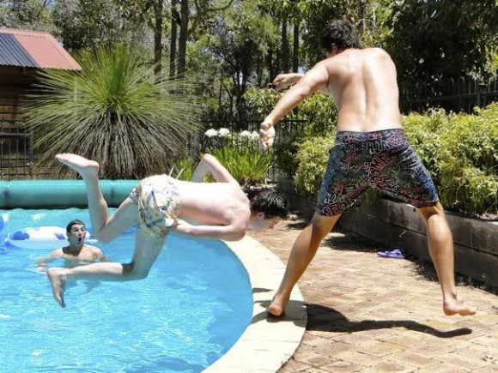
RNA-seq, yet again

Slide 2
Fun and games
The senior bioinformation send you an email that only says:
/scratch/Shares/public/sread2021/data_files/day8/morebamfiles/README.txt

Slide 3
Stop and think
What programs will you use?
What input files will you use?
What will the results look like?

Slide 4
Schedule
30 min create the counts table
30 run DEseq2
15 min look at the results
30 min plot the fold changes

Slide 5
Stop and start the next section
Run DEseq on your counts table. Here is mine (since yours is probably still running – and to save compute resources, stop your job.)
/scratch/Shares/public/sread2021/cookingShow/day8/RNAseqextras/counts/featureCounts.txt
Advanced students may also use
/scratch/Shares/public/sread2021/cookingShow/day8/RNAseqextras/counts_just21/featureCounts.txt

Slide 6
Stop and start the next section
Which are the most significant genes?
What pathways do they function in?
My DEseq results are in:
/scratch/Shares/public/sread2021/cookingShow/day8/RNAseqextras/deseqresults/
Advanced students may also use
/scratch/Shares/public/sread2021/cookingShow/day8/RNAseqextras/deseqresults_just21/

Slide 7
Stop and start the next section
Plot the chr21 genes fold change (probably easier in RStudio)
My DEseq results are in:
/scratch/Shares/public/sread2021/cookingShow/day8/RNAseqextras/deseqresults/all_results.csv
Advanced students may also use
/scratch/Shares/public/sread2021/cookingShow/day8/RNAseqextras/deseqresults_just21/all_results.csv

