Slide 1
Short Read Sequencing Analysis Workshop
Day 8 Part 2. Single Cell RNA-Sequencing
In-Class Slides

Slide 2
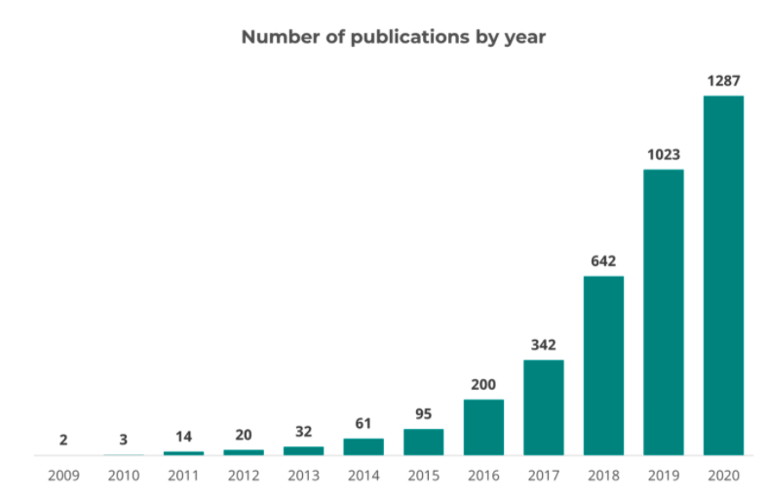
Timeline of scRNA-Seq
Source: Pubmed, September 2020

Slide 3
10x Genomics Platform
10x Genomics Training Slides

Slide 4
Library
Sample Index: Experiment
10x Barcode: Droplet (0 or 1 cell)
UMI: Transcript
Expression Matrix
(# transcripts/gene/10x barcode)
Mapping, Counting, etc
https://assets.ctfassets.net/an68im79xiti/3ext0GjeynnDQezv1iRP5u/7b73f52769728575ce696b8f679f82db/CG000204_ChromiumNextGEMSingleCell3_v3.1_Rev_B.pdf

Slide 5
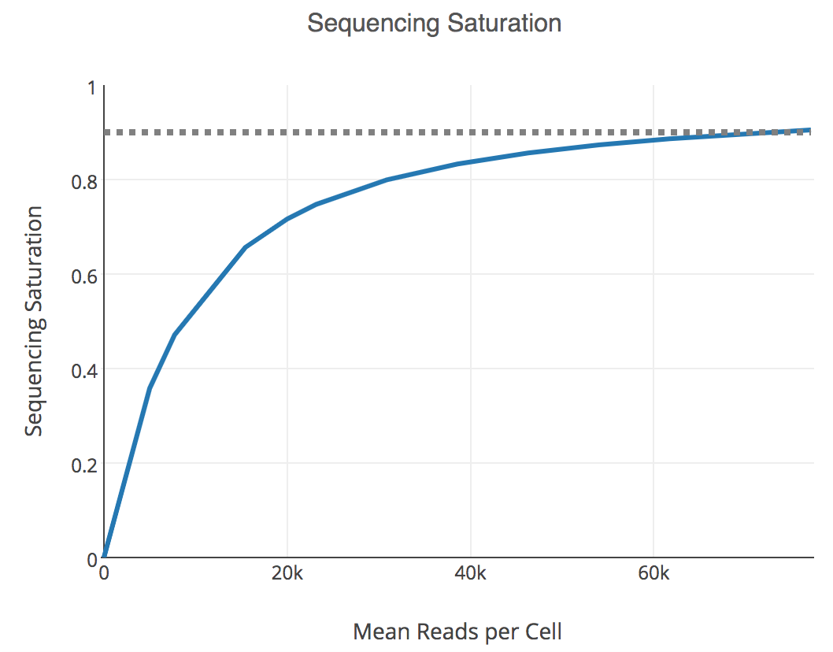
Key Experimental Parameters
# Cells to sequence
Sufficiently large to be able to identify rare subpopulations
Cost is proportional to the number of cells to sequence
Sequencing depth (# reads/cell)
Higher depth -> More chance to detect transcripts
Benchmark studies showed that saturated at 0.5 M reads/cell
Cost is proportional to the sequence depth
1-P(detect a new transcript)

Slide 6
Analysis Pipeline
Raw Reads
QC
Mapping
Expr. Matrix
QC
Expr. Matrix
transcripts/gene/10x barcode
transcripts/gene/cell
Clustering
Trajectory Inference
Diff. Expr. Genes
DEA
Cluster (Cell Type)
Construction of expression matrix: CellRanger (10x Genomics)
Downstream analysis: CellRanger (10x Genomics), Seurat (Rahul Satija),
Scran (John Marioni), Monocle (Cole Trapnell), Scanpy (Fabian Theis)

Slide 7
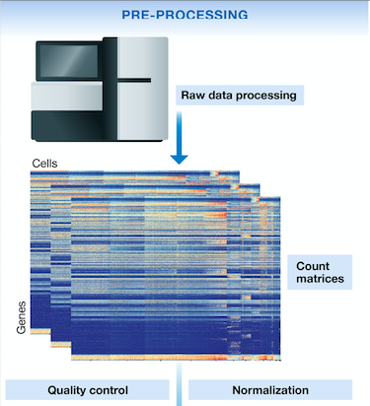
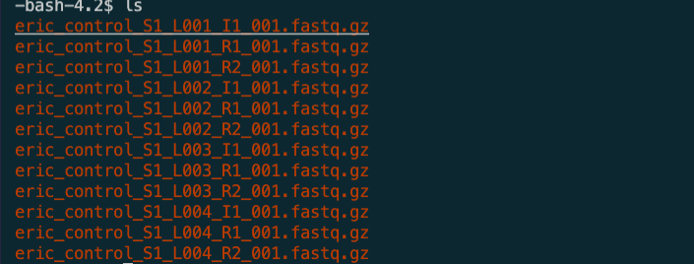
Analysis Pipeline
Cell ranger
Luecken, Malte D., and Fabian J. Theis. Molecular systems biology 15.6 (2019): e8746.

Slide 8
Quality Control
Seurat
Mitochondrial gene percentage
Number of gene
Number of UMI

Slide 9
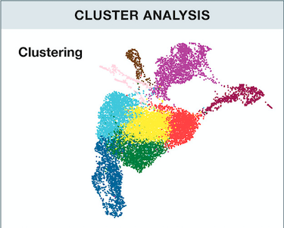
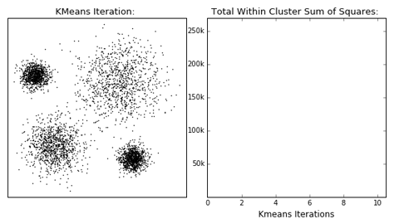
Downstream Analysis – Cell Level
Cell ranger
K means clustering
Luecken, Malte D., and Fabian J. Theis.
Molecular systems biology 15.6 (2019): e8746.
https://dashee87.github.io/data%20science/
general/Clustering-with-Scikit-with-GIFs/

Slide 10
Downstream Analysis – Cell Level
Seurat,
Scanpy
Graph Clustering
Luecken, Malte D., and Fabian J. Theis. Molecular systems biology 15.6 (2019): e8746.
Liu, Zijing, and Mauricio Barahona.
Applied Network Science 5.1 (2020): 1-20.

Slide 11
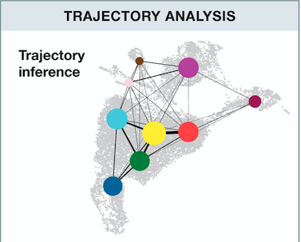
Downstream Analysis – Cell Level
Monocle: Linear and bifurcation trajectory
PAGA: + Disconnected graphs
scVelo: + Directionality
Saelens, Wouter, et al. Nature biotechnology 37.5 (2019): 547-554.

Slide 12
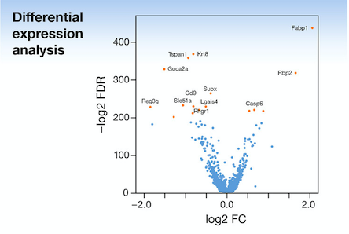
Downstream Analysis – Gene level
Seurat
Luecken, Malte D., and Fabian J. Theis. Molecular systems biology 15.6 (2019): e8746.

Slide 13
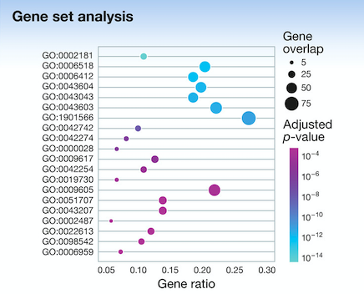
Downstream Analysis – Gene level
Seurat
Luecken, Malte D., and Fabian J. Theis. Molecular systems biology 15.6 (2019): e8746.

Slide 14
Today’s Tasks
Part 1. Running CellRanger
Part 2. Understanding the outputs of scRNA-seq analysis

Slide 15
Raw data
The filename of fastq file must have the following format,
[Sample Name]_S1_L00[Lane Number]_[Read Type]_001.fastq.gz, otherwise it won’t be able to find them

Slide 16
Part 1. Run CellRanger
Copy a sbatch template from /scratch/Shares/public/sread2021/scripts/day8/
Request 4 cores, 1hr running time, and 16GB memory
Load cellranger by module load cellranger/3.0.1
Determine the values of the arguments of cellranger count
Submit the job

Slide 17
Part 1. Run CellRanger
The arguments are
<job_name>: Any job name you like.
<path_to_ref_genome>: /scratch/Shares/public/sread2021/data_files/day8/refdata-gex-GRCh38-2020-A
<path_to_fastq>: /scratch/Shares/public/sread2021/data_files/day8/eric_control_subsample
<sample_name>: eric_control
Run eric and ethan samples through two different sbatch files

Slide 18
Part 2. Understand the Outputs
Go to /scratch/Shares/public/sread2021/data_files/day8/output
2 Datasets
Two datasets Ethan_Control and Eric_Control
Transfer the web_summary.html file from each dataset to your local computer
Answer the questions on the worksheet with the information from the files.

