Slide 1
2019 Short Read Sequencing Analysis Workshop Day 6
RNA-seq: Differential gene expression analysis

Slide 2
What do we need for Differential Expression Analysis?
PREVIOUSLY…
(featureCounts)

Slide 3
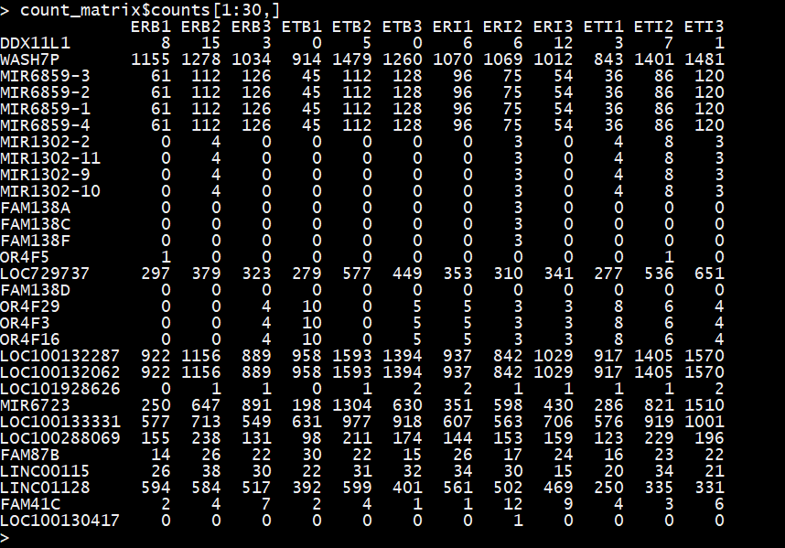
Where did we leave off?

Slide 4
Say we independently sample (multiple times) the number of RNA molecules that came from a given gene...
$$μ$$
one sample
probability
counts
DESeq2 attempts to answer the following: Assuming a negative-binomial distribution for blue, do the red samples come from the same distribution?

Slide 5
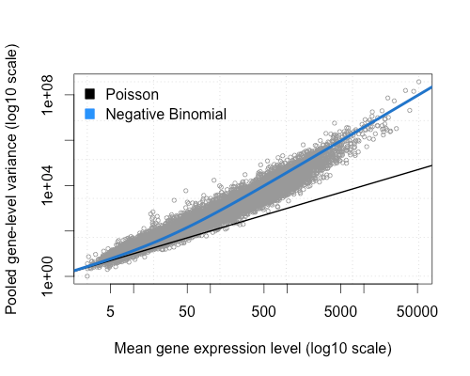
Statistical assumptions…
Assumption 1: expression level of most loci are not changing, i.e. the average log fold change is approximately zero.
The variance of the counts for any loci can be modeled by the negative binomial distribution, i.e. variance is proportional to the square of the mean. For a given loci:
$$Var=μ+α⋅μ^{2}$$
where $μ$ is the average expression level of the gene and $α_{i}$ is the “dispersion” factor (we will return to this)

Slide 6
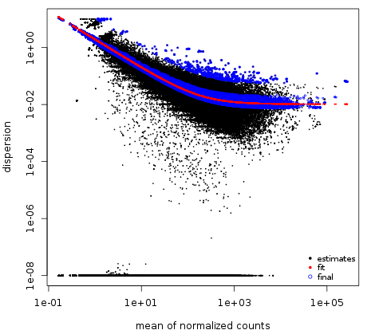
Dispersion ($α$) model
$$α(μ)= \frac{a}{μ}+μ_{0}$$
$$Var=μ+α⋅μ^{2}$$
$$Var=μ+α(μ)⋅μ^{2}$$
$$=μ+\left(\frac{a}{μ}+μ_{0}\right)⋅μ^{2}$$
$$=μ+aμ+μ_{0}μ^{2}$$

Slide 7
What is our experiment?
Genotype
Disomy 21
Trisomy 21
BSA
(control)
3 replicates
3 replicates
Treatment
Interferon
3 replicates
3 replicates

Slide 8
Load counts data and define experimental conditions
You can look at the contents of your workspace:
Check to make sure the data files and IDs correspond to the correct experimental conditions:

Slide 9
Convert your counts table into a DESeq data set
Load the DESeq2 library:
Compile the counts, experimental conditions table and the design matrix into a DESeqDataSet:
Check that its dimensions, row names, and column names are correct:

Slide 10
Experimental design
The “design” variable is essential, in that it specifies what factors you want DESeq to consider when running its statistical tests.
Simplest example:
Group by single column condition/genotype
In the above case would be either “chr21” or “ifn_treat” and the comparison would ignore the other column
design = ~condition
Conditional interaction:
Include mixed interaction of multiple conditions accounting for interaction
design = ~genotype+ condition + genotype:condition
This separates out the main effect from the primary condition, plus the effect associated with the interaction. Answers: is the condition effect different across genotypes?
https://github.com/mikelove/DESeq2/blob/master/R/results.R

Slide 11
Experimental design
Finally, what if we simply wanted to identify the effect of the treatment on each genotype independently? Answer: We need to create a new grouping.
Create new labels that combine genotype and condition:
Apply this same process to your DESeq data structure:
dds$group <- factor(paste0(dds$genotype, dds$condition))
https://github.com/mikelove/DESeq2/blob/master/R/results.R

Slide 12
Filter out non-informative loci
Loci that have no count data are uninformative and so can be removed. Here you see the counts are zero for the first rows:
These can be filtered out as follows (use nrows() to check how many rows are removed):
Now you can see at least one of the samples contains some counts for each row:

Slide 13
Main computation/fitting
Now that your DESeqDataSet object contains all the necessary information, you can run the main function to compute the model fit:
Once complete, you can look at a summary of all the data it contains. The row, column, and count data is transferred from the input data object:

Slide 14
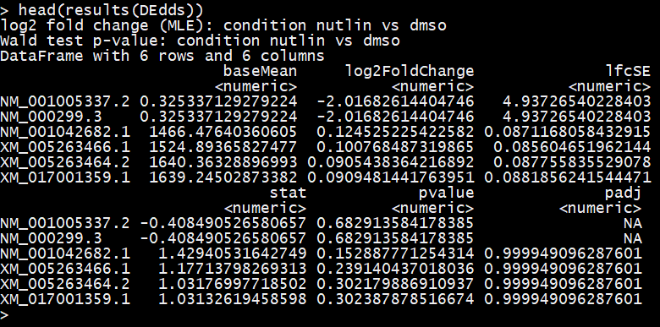
Contents of the results
Mean counts for control condition
Log fold change
Uncertainty on log fold change
Value of statistic (Wald test) for calculating p-value
adjusted p-value
p-value

Slide 15
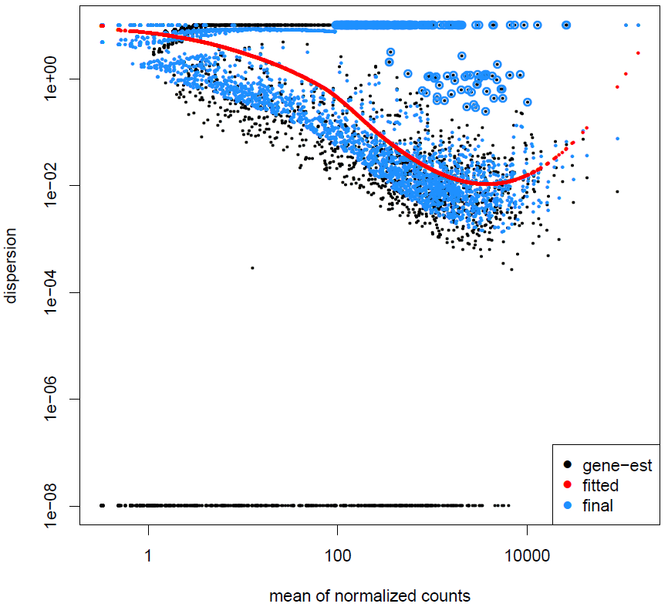
Estimating dispersion ($α$)
Here’s an example some data that does not follow this trend:
DESeq2 assumes the estimated dispersion follows a power law:
$$α(\overline{μ})= \frac{a}{\overline{μ}}+μ_{0}$$

Slide 16
Set significance threshold and extract results
In order to extract your significant results, you must specify your significance threshold ($α$) and indicate what are the treatment and control conditions:
The results() function will then identify the values for the given threshold and comparison:
Log fold shrinkage reduces the large variance in log-fold change for loci with low counts. This is done primarily for the purpose of visualization. It does not change the significance of any loci

Slide 17
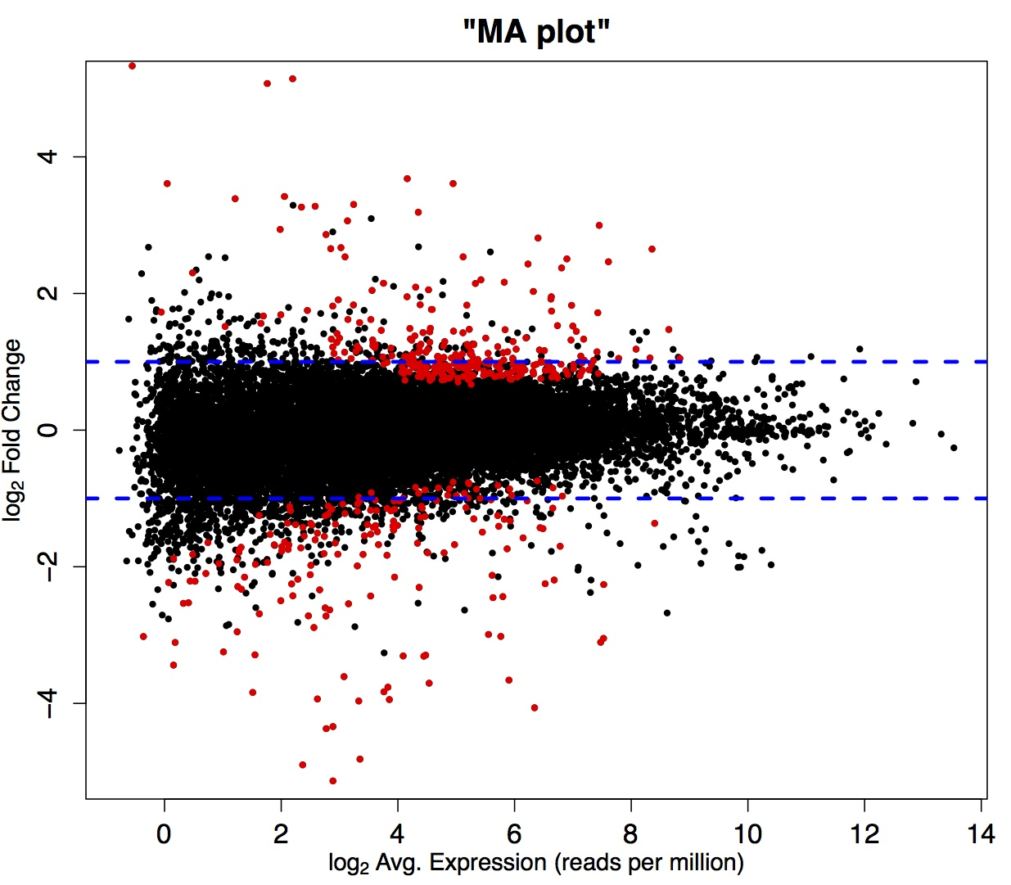
MA plotting
The cluster of non-significant loci should be centered at zero.
Red points indicate loci that were determined to be significant
The log-fold change at which something is significant should depend on the average expression level (since sample variance depends on average expression)

Slide 18
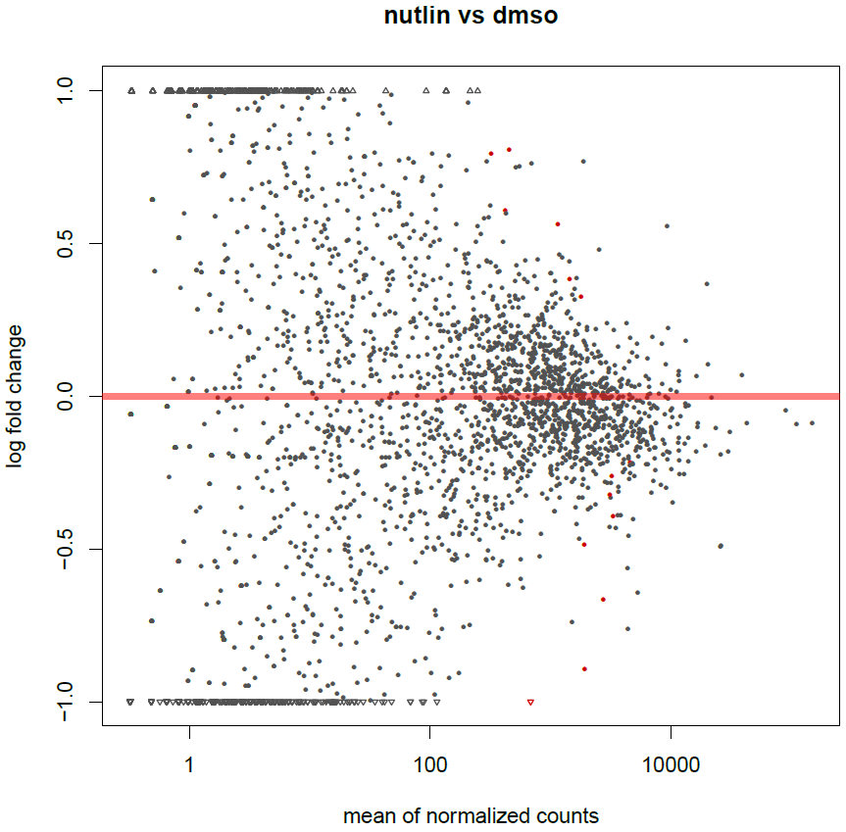
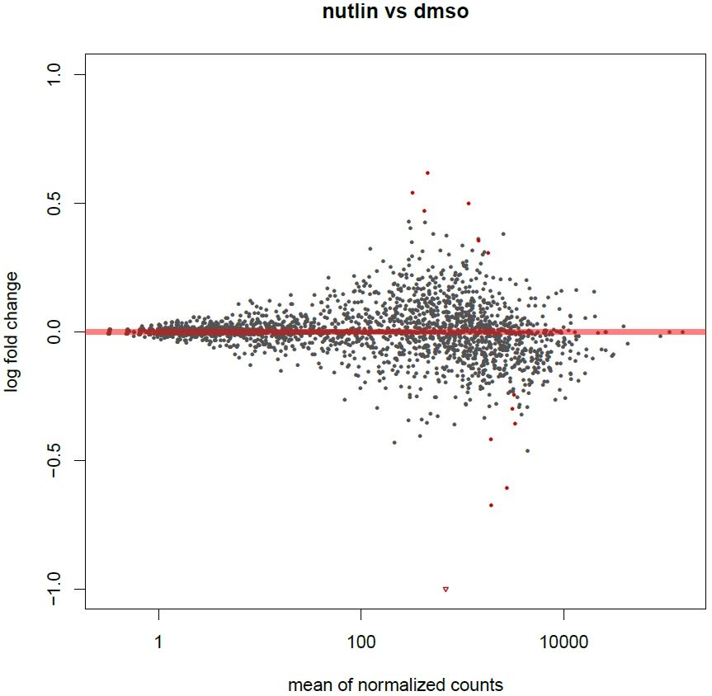
MA plotting and log-fold shrinkage

Slide 19
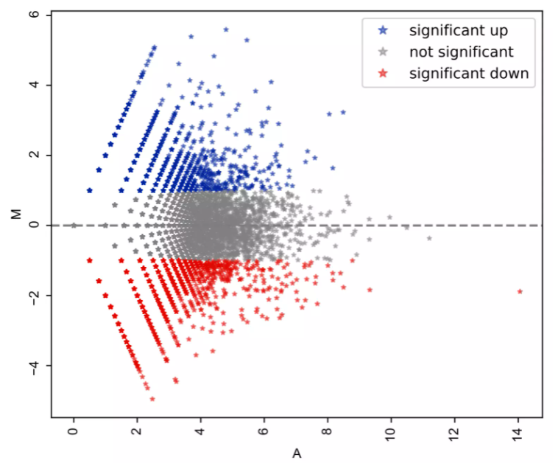
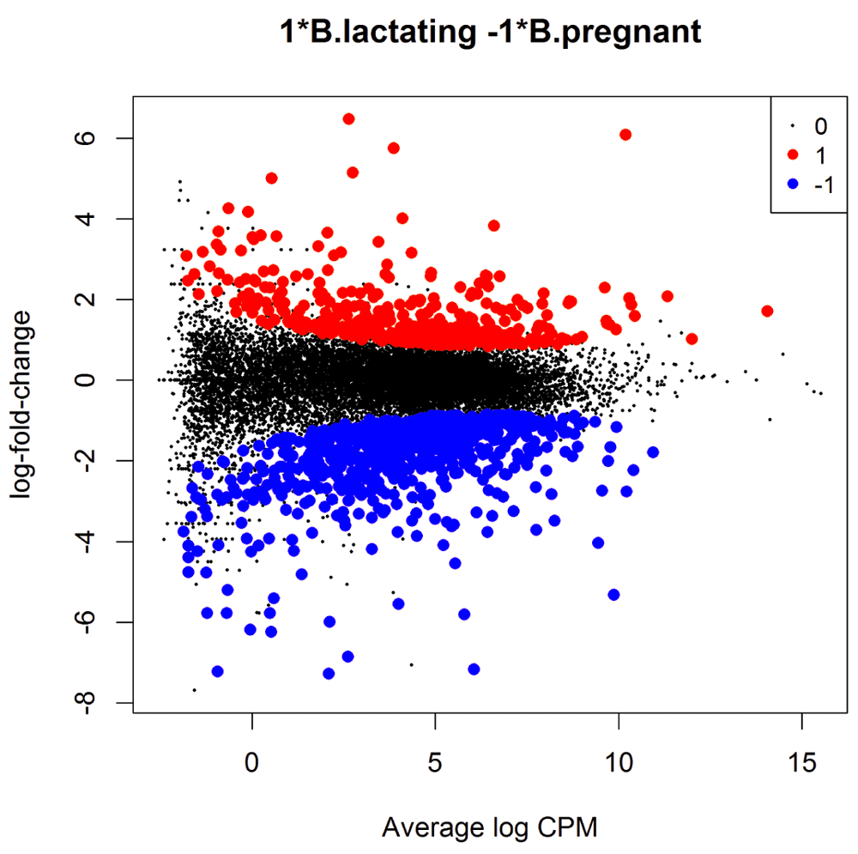
Significance levels in MA plots
Example of an MA plotting using a fixed fold change to determine significance
Example of an MA plotting using mean dependent variance estimate.

Slide 20
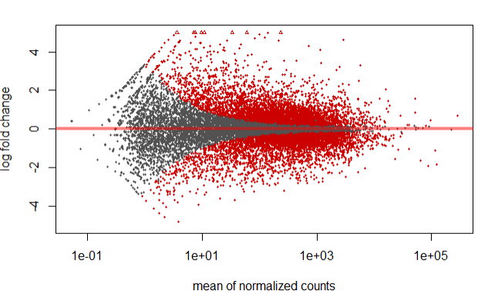
Significance levels in MA plots
Here we see there is no clear delineation between what is “significant” (red dots) and non-significant (a.k.a. “background”, in grey)
Possible explanations:
Over dispersion is under-estimated
Your significance level is not stringent enough

Slide 21
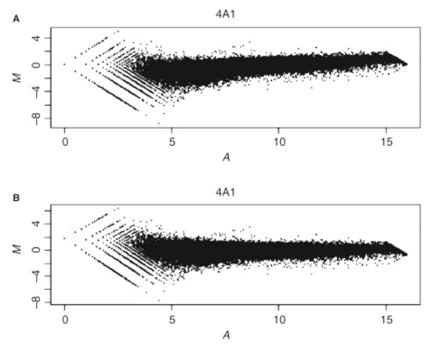
How MA plots can go wrong
If your libraries are not properly normalized this can manifest as a “trend” in the background distribution of loci.
Top plot shows a positive relationship between the M and A dimensions---higher fold change correlates with higher average expression.
Bottom plot shows the same results after a normalization correction.
https://www.sciencedirect.com/topics/biochemistry-genetics-and-molecular-biology/ma-plot

Slide 22
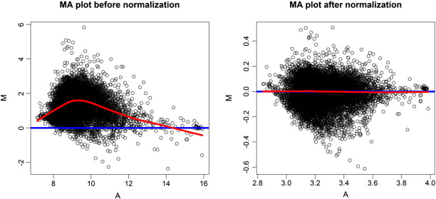
How MA plots can go wrong
Here’s another example of an MA plot being impacted by improper normalization and how it appears after normalization correction.
https://www.sciencedirect.com/topics/biochemistry-genetics-and-molecular-biology/ma-plot

Slide 23
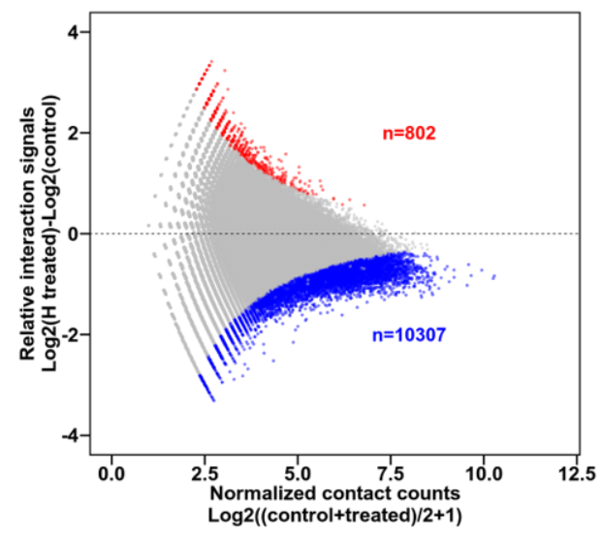
How MA plots can go wrong
Here we have an MA plot that has both a trend bias (correlation between M and A dimensions) as well as a constant offset (everything is shifted down)
https://www.biostars.org/p/486360/

Slide 24
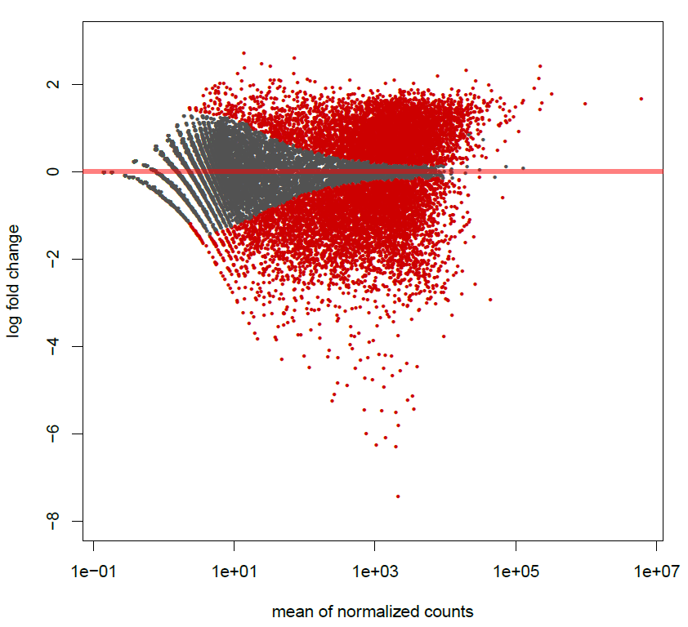
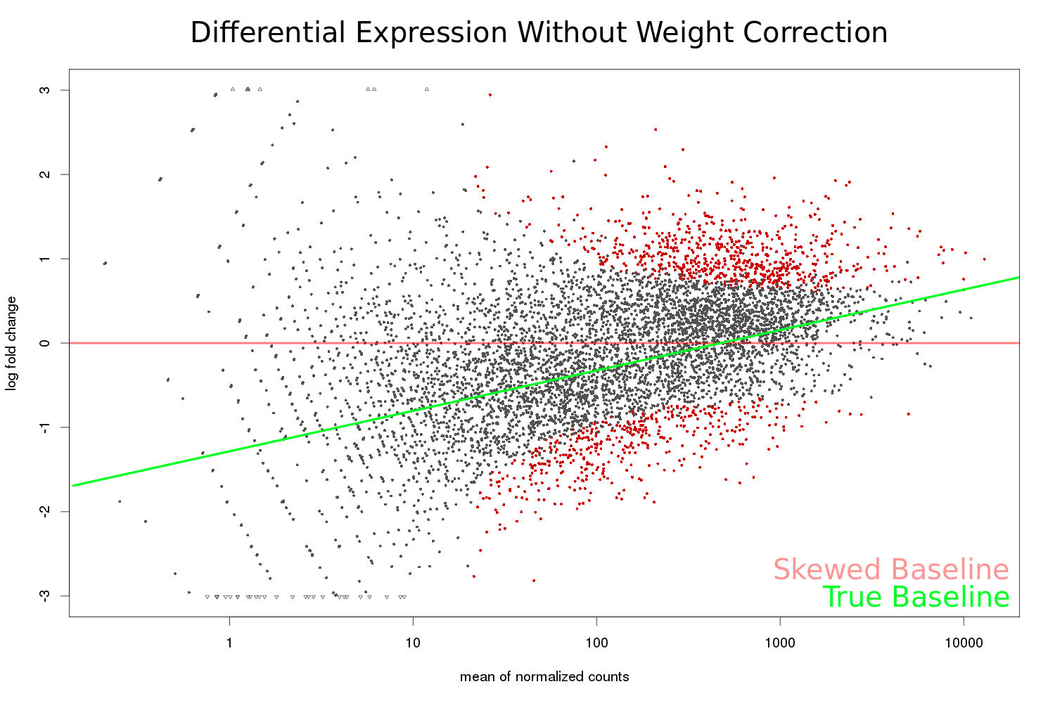
How MA plots can go wrong
This MA plot demonstrates how your choice of significance level underestimates the degree of variability in your background fold change
An MA plot showing a background trend. The adjusted background baseline is shown in green.

Slide 25
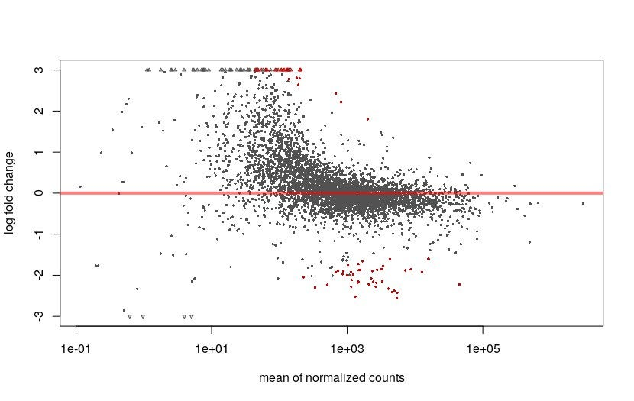
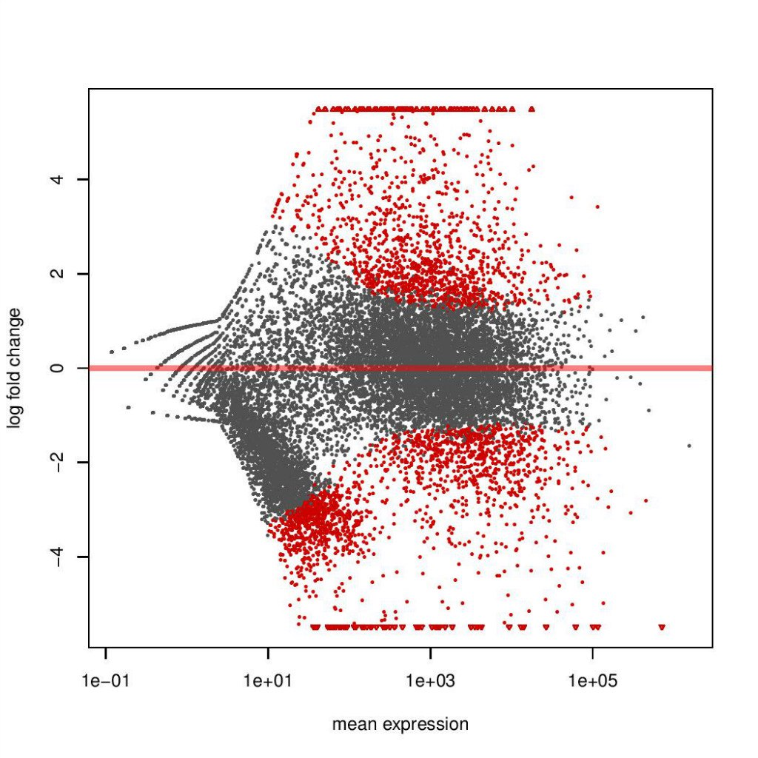
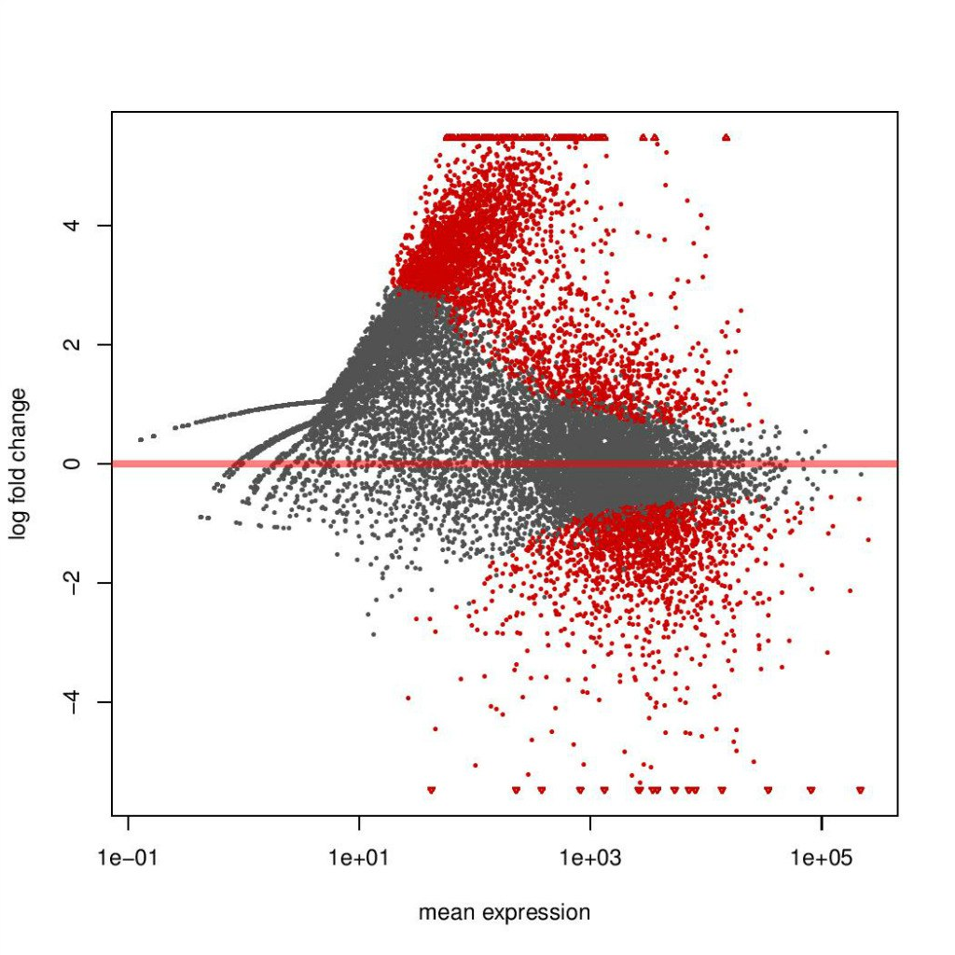
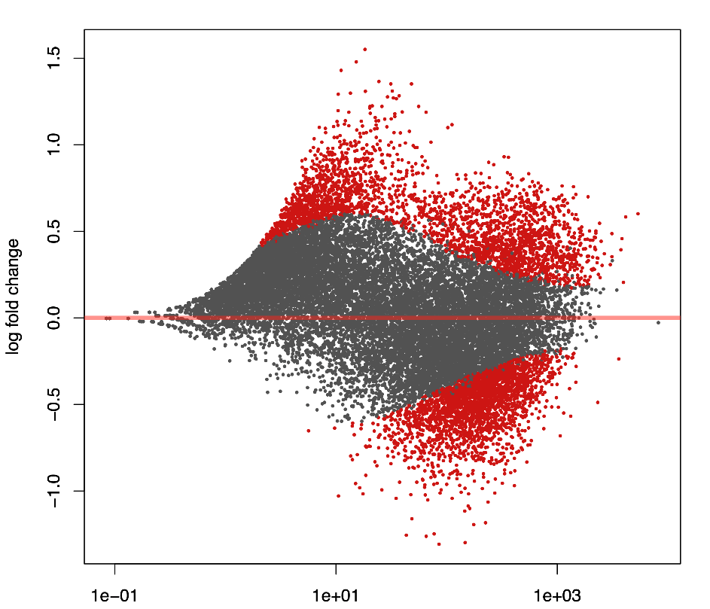
How MA plots can go wrong
Sometimes an MA plot isn’t “wrong” because of a technical issue.
If your experimental expectation does not match the base assumptions of DESeq (or any other DEA tool), you should be skeptical of your results.

Slide 26
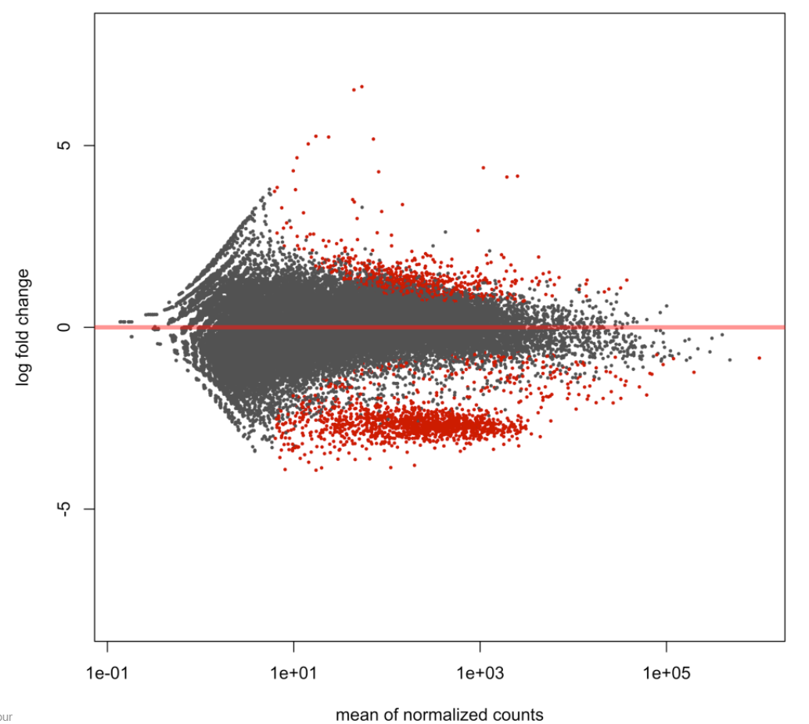
Is this good or bad?
This MA plot was called into question (for one, the experimental design did not expect a large cluster decreased loci):
There seems to be a small downward trend in the background. So, perhaps there’s a normalization issue, however minor.
Other possibilities:
contamination---the cluster may be an “MA plot in an MA plot”
There’s actually a down-regulated signal the user did not expect!
https://www.biostars.org/p/284786/

Slide 27
Saving your results
Sort the results by adjusted p-value and only select those that are below the chosen alpha value threshold:
These significant results can then be written to a csv file, which can be opened in excel:

Slide 28
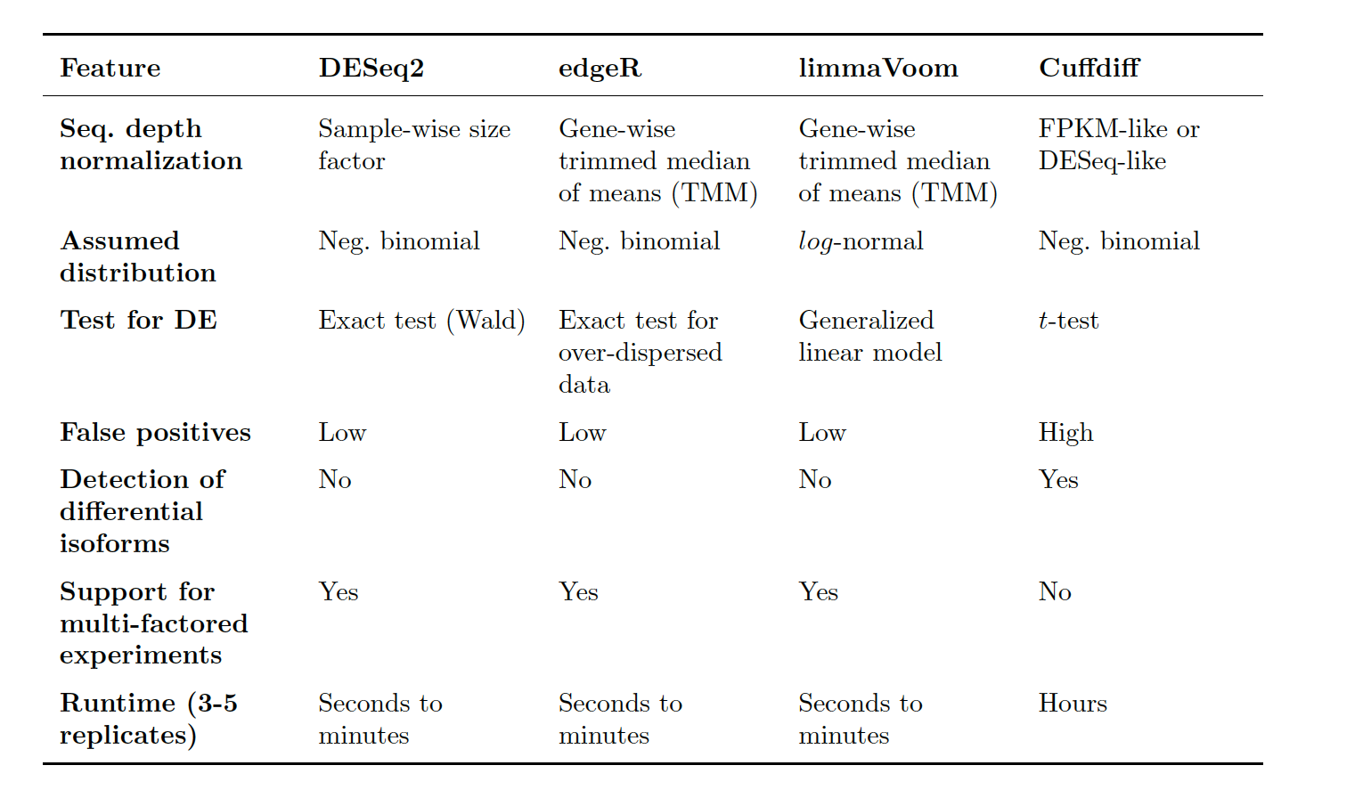
Other methods are available:

Slide 29
General advice:
Emphasize more replicates rather than deeper sequencing per replicate (results in better estimation of variance)
There is no one perfect tool for differential expression analysis
For robust results, use multiple methods and look at the loci they have in common
Look at your data (MA plot, dispersion estimates, etc.)

