Slide 1
Short Read Day 4
Pt. 2
Read Mapping and Visualization
Qing Yang
Sawyer Lab, Dowell & Allen Lab
Biofrontiers Institute
qing.yang@colorado.edu

Slide 2
NGS Data Processing Pipeline at a glance
Raw Reads
(.fastq)
FASTQC
Read Trimming
(Trimmomatic)
FASTQC
Read Mapping
(HISAT2)
File Conversion
Analysis-Ready Mapped Reads (.bam)
Visualization

Slide 3
Read Mapping using HISAT2

Slide 4
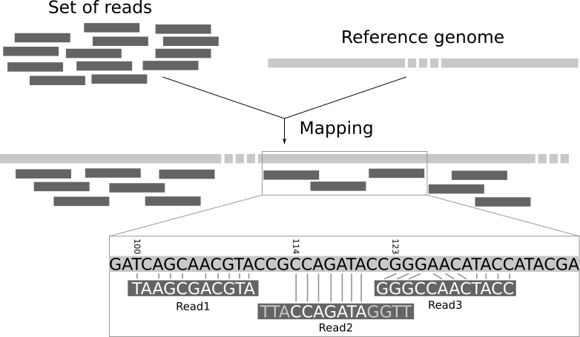
Read mapping at-a-glance

Slide 5
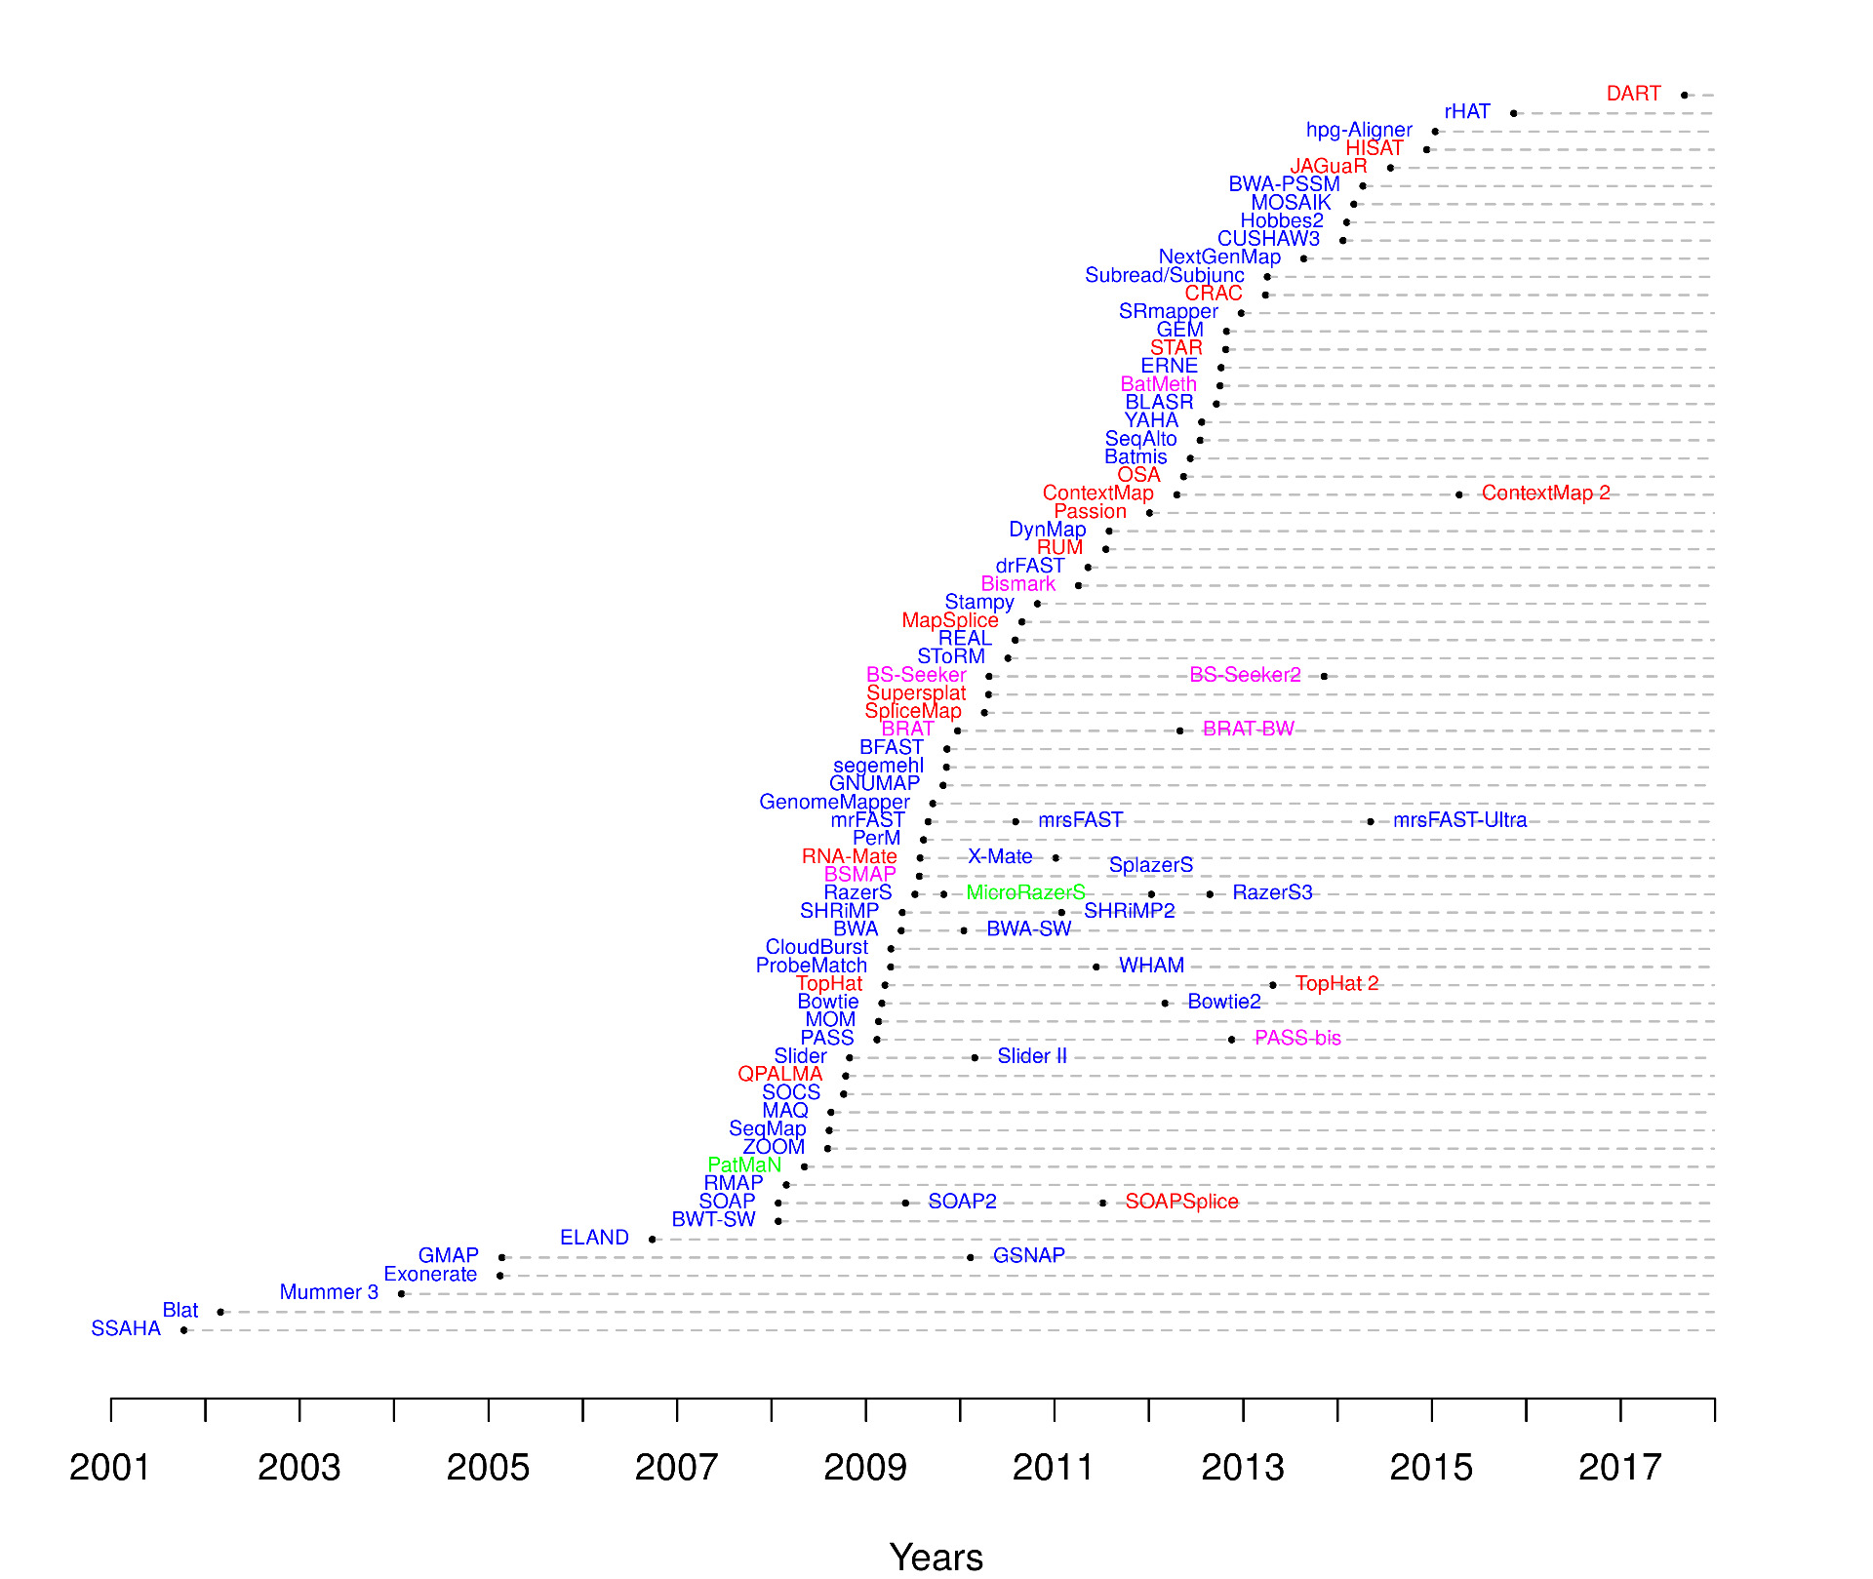
Types of read mappers
Different read mapping softwares are tailored
for different types of sequencing analysis:
RNAseq RNA Splicing
Methyl-seq Modification
Genome sequencing Variants/SNPs

Slide 6
HISAT2 read mapping
Hierarchical Indexing for
Spliced Alignment of Transcripts
Case 1:
Read mapped
to a single exon
Case 2:
Read spans
exon junction

Slide 7
Required input files for HISAT2
Reference Genome Index Files
/scratch/Shares/public/genomes/hisatfiles/hg38/HISAT2/genome
Trimmed Pair-end Sequencing Reads
chr21Eric_repA.RNA.end1.trimmed.fastq
chr21Eric_repA.RNA.end2.trimmed.fastq

Slide 8
Read mapping via HISAT2
hisat2 --very-fast
-x /scratch/Shares/public/genomes/hisatfiles/hg38/HISAT2/genome \
-1 ${INPUT_DIRECTORY}/chr21Eric_repA.RNA.end1.trimmed.fastq \
-2 ${INPUT_DIRECTORY}/chr21Eric_repA.RNA.end2.trimmed.fastq \
> ${OUTPUT_DIRECTORY}/chr21Eric_repA.sam \
2> ${OUTPUT_DIRECTORY}/chr21Eric_repA.hisat2_mapstats.txt
Genome Index
Trimmed Reads
Output: Mapped Reads
Output: Mapping Statistics

Slide 9
Inside of HISAT2 Output SAM File
hbctraining

Slide 10
Converting Mapped Reads to Sorted BAM files
Step 1: SAM to BAM
samtools view -@ 8 -bS -o ${OUTPUT_DIRECTORY}/chr21Eric_repA.RNA.bam ${OUTPUT_DIRECTORY}/chr21Eric_repA.RNA.sam
Step 2: Sort BAM
samtools sort -@ 8 ${OUTPUT_DIRECTORY}/chr21Eric_repA.RNA.bam > ${OUTPUT_DIRECTORY}/chr21Eric_repA.RNA.sorted.bam
Step 3: Index BAM
samtools index ${OUTPUT_DIRECTORY}/chr21Eric_repA.RNA.sorted.bam ${OUTPUT_DIRECTORY}/chr21Eric_repA.RNA.sorted.bam.bai

Slide 11
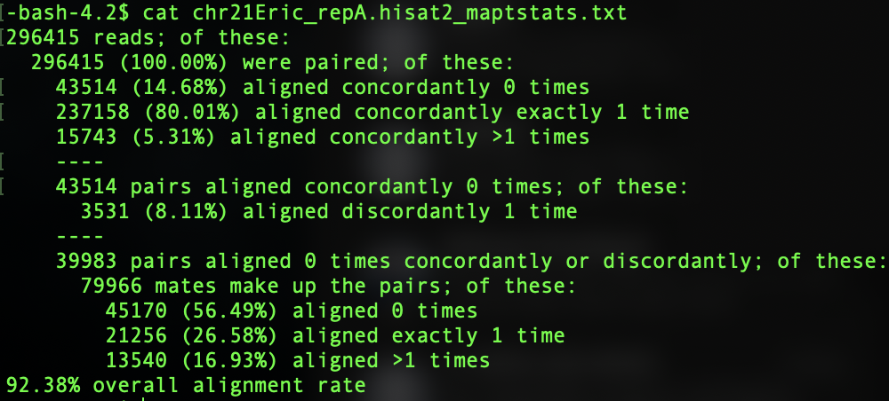
Examine mapping quality

Slide 12
Read visualization using IGV

Slide 13
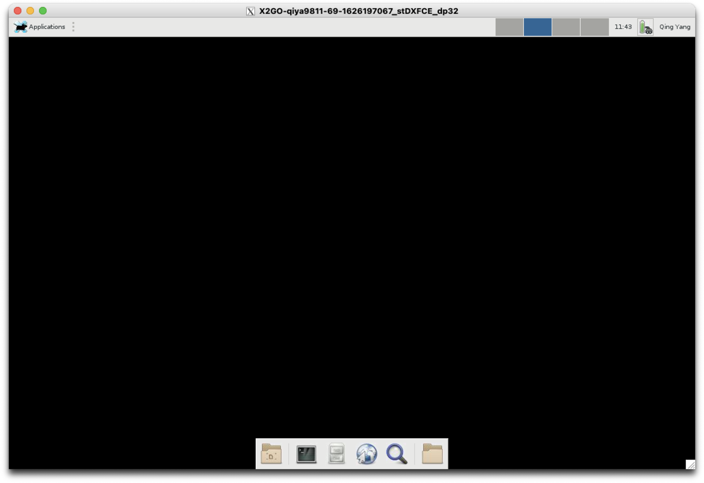
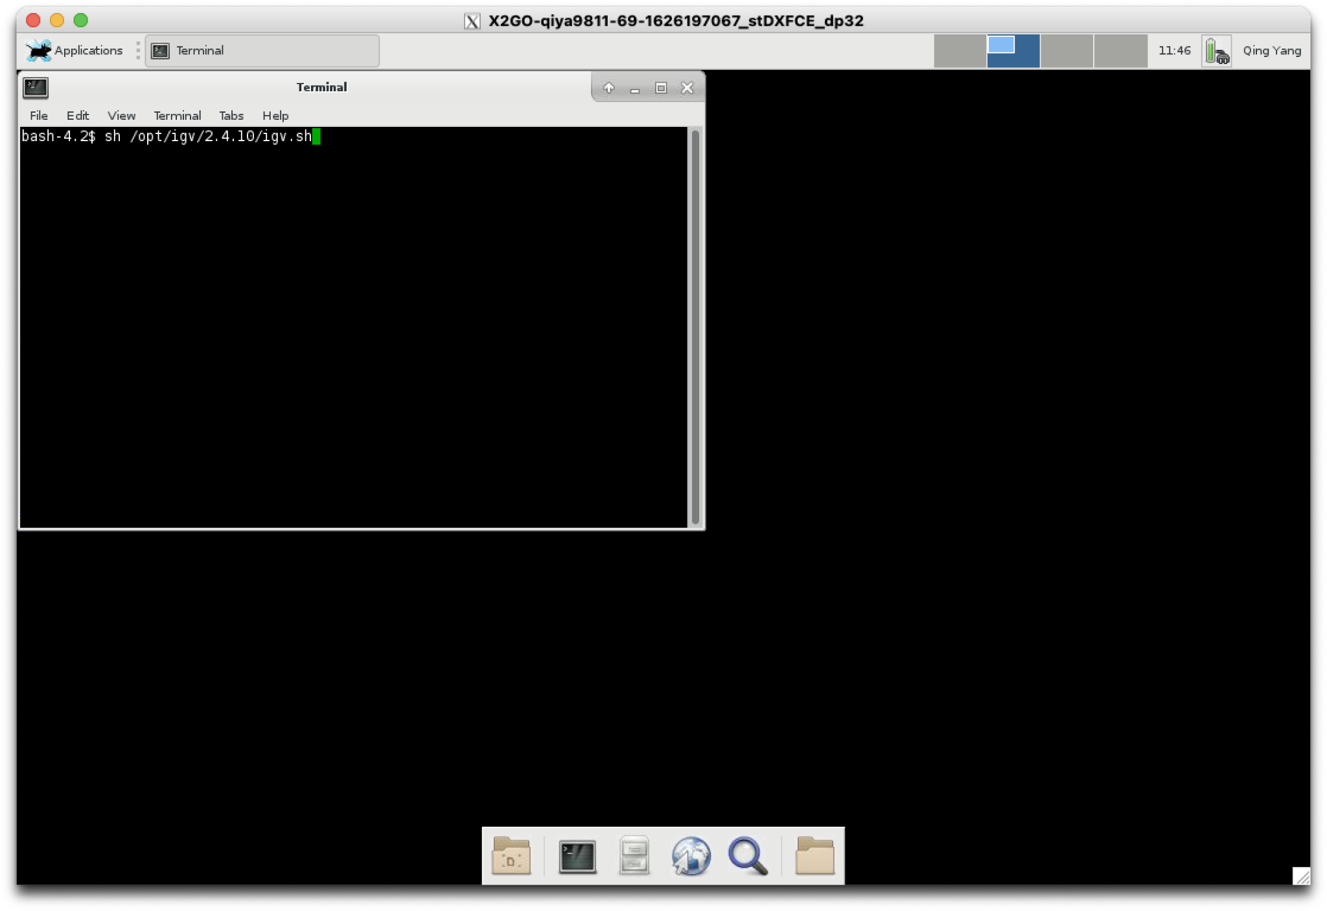
Connecting to IGV via X2GO Client
Open terminal on the server GUI
Launch IGV from the terminal:
bash-4.2$: sh /opt/igv/2.4.10/igv.sh

Slide 14
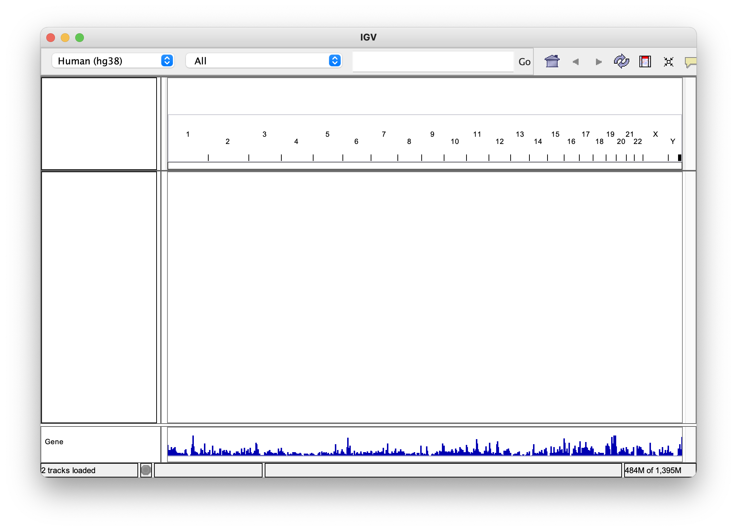
Configure IGV to view BAM files
Select the same genome used as reference for read mapping

Slide 15
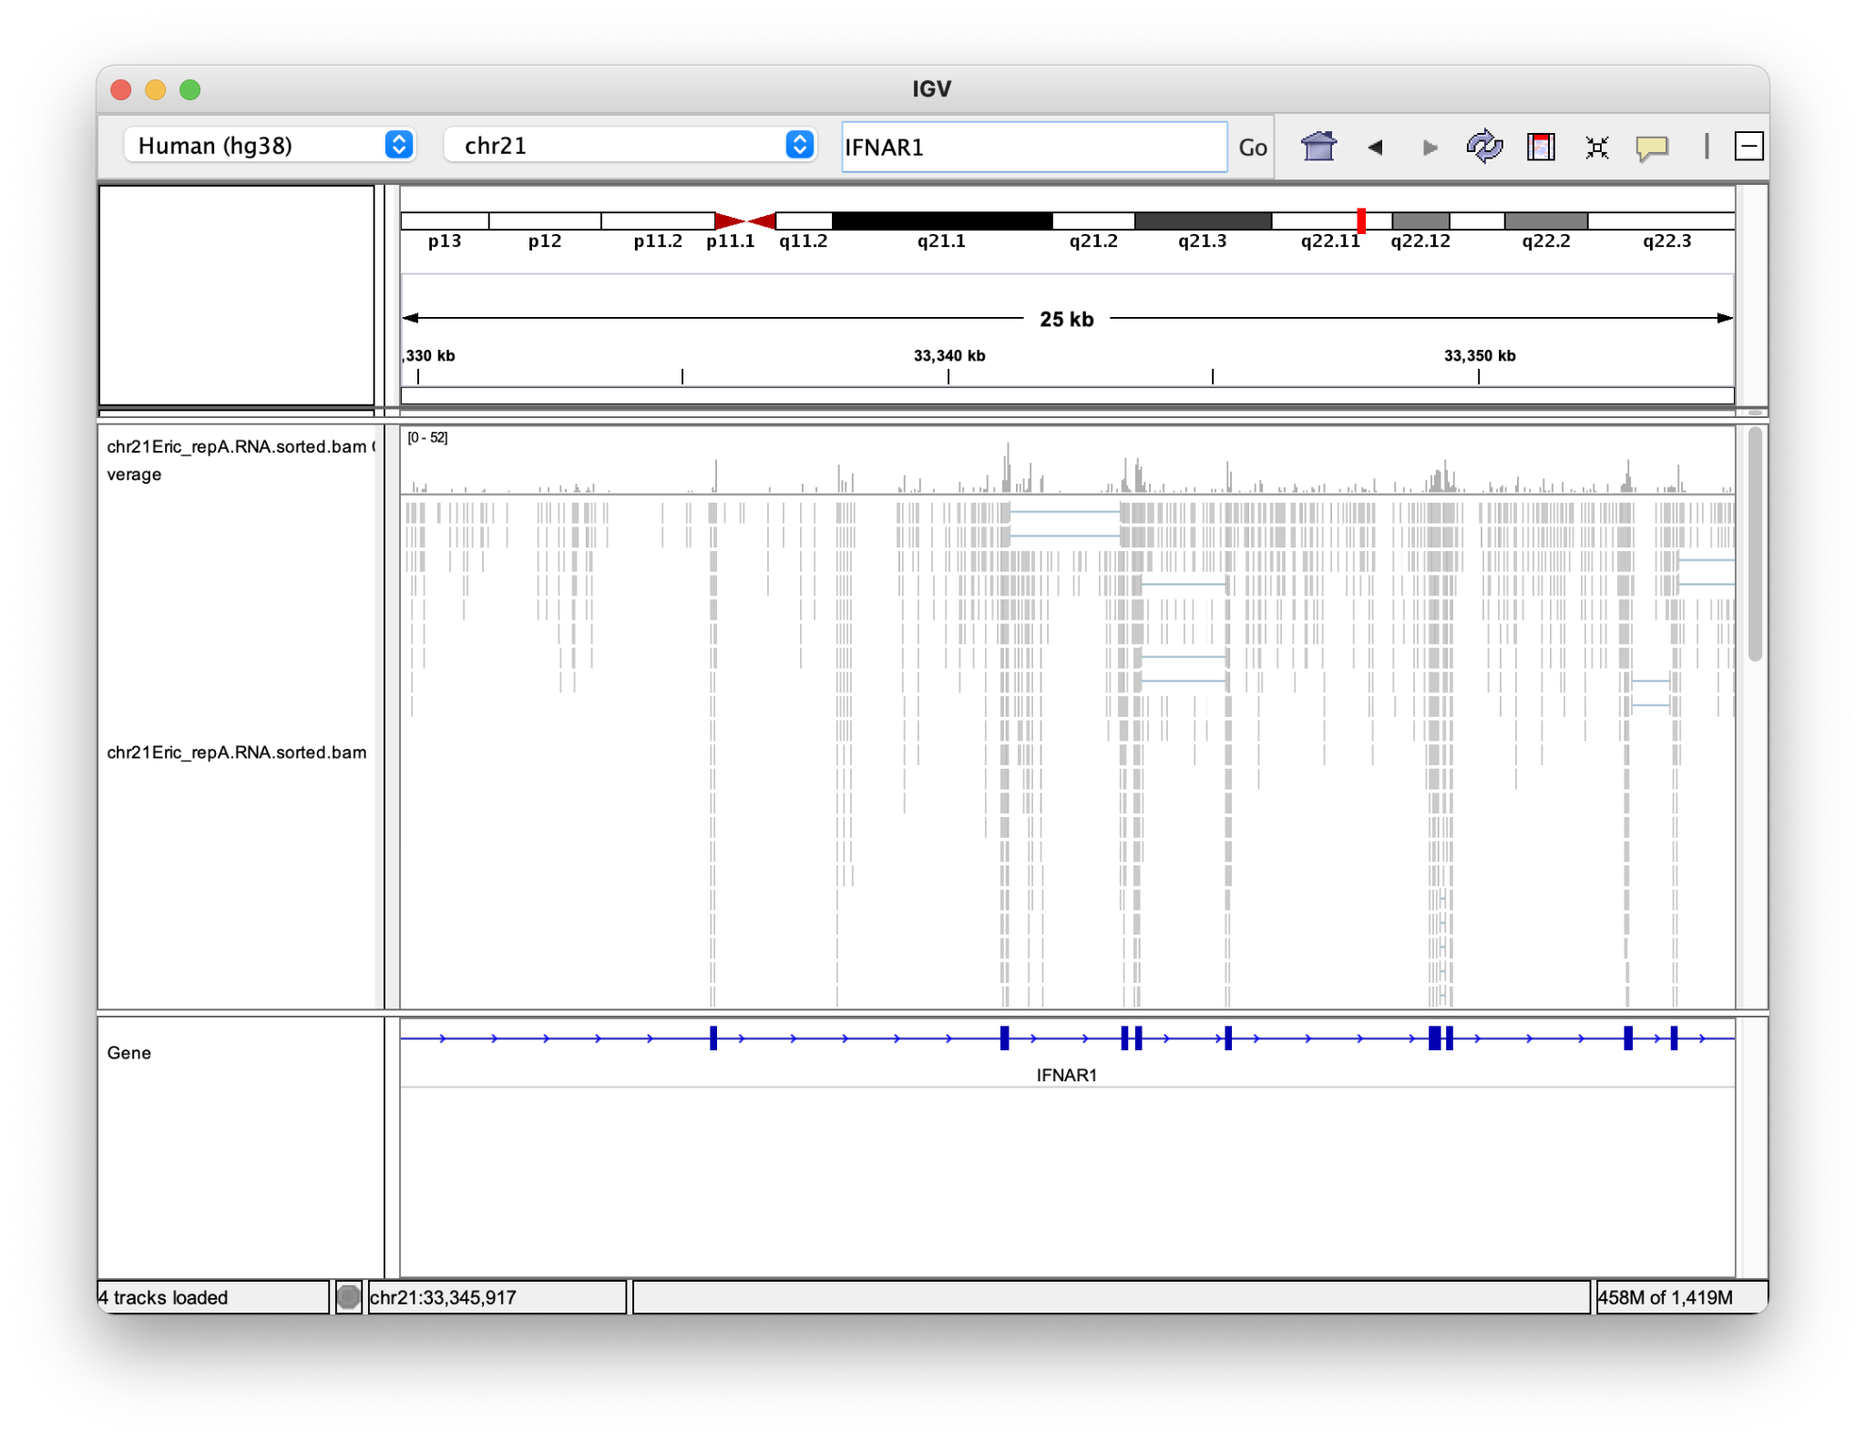
Load BAM files from the output folder
File -> Load From File -> Select chr21Eric_repA.RNA.sorted.bam from the output folder
As an example, type in IFNAR1 in the coordinate box
Read
Coverage
You might need to zoom in a little to see alignment
Read mapping details

Slide 16
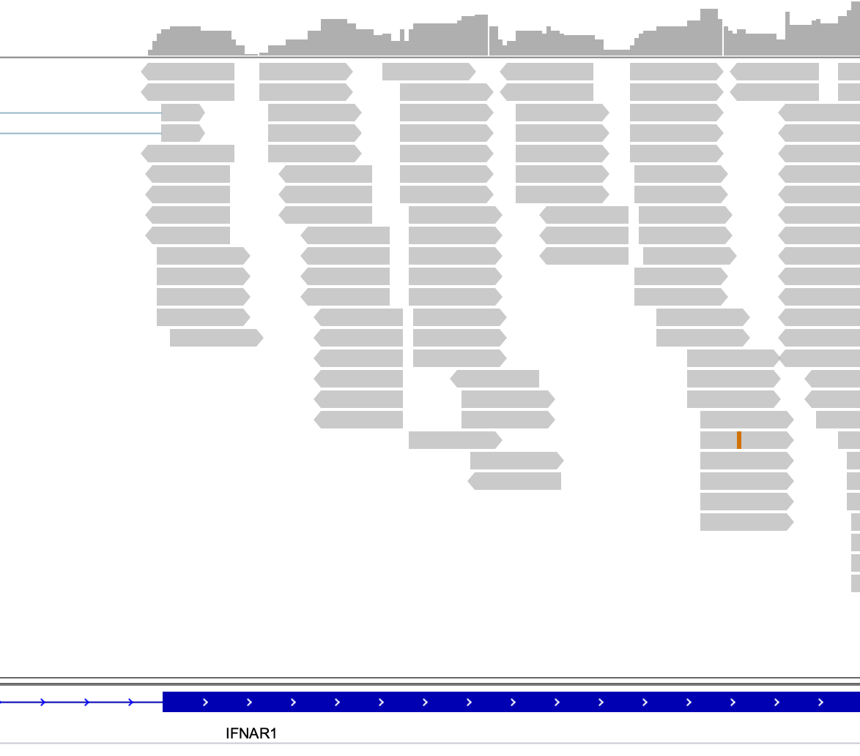
Key information from read visualization
Read Coverage
Read Pairs
Exon Spanning Reads
SNP vs. Sequencing Error

Slide 17
NGS Data Processing Pipeline at a glance
Raw Reads
(.fastq)
FASTQC
Read Trimming
(Trimmomatic)
FASTQC
Read Mapping
(HISAT2)
File Conversion
Analysis-Ready Mapped Reads (.bam)
Visualization

