Slide 1
Day 10

Slide 2
What am I going to do now
Read
Practice

Slide 3
How do I make a for loop (serial)
/scratch/Shares/public/sread2021/scripts/aforloop.sh

Slide 4
How do I make a for loop (parallel)
/scratch/Shares/public/sread2021/scripts/day10/downloadfromgeo/downloadall.sh
/scratch/Shares/public/sread2021/scripts/day10/downloadfromgeo/downloadafastq.sbatch

Slide 5
What do I do with Deseq2 results?
Rscript to pull out all genes vs. sig genes (Mary)
Enrichr (Jesse)
DAVID GO (Jesse)
GSEA (Zach)
Single cell sequencing gene (Jesse)

Slide 6
Where can I find public data?
Everywhere!!!
Allen lab useful tools blog post
ATACseq and Chip-seq=Cistrome (http://cistrome.org/db/#/)
GEO NIH
Gtex (RNA-seq)

Slide 7
How do I download public data fastqs?
First you need a SRR#
Search NIH GEO for anything you want (https://www.ncbi.nlm.nih.gov/geo/)
Find a SRP#, a SRR#, or a SRX#
Search NIH SRA Run Selector for the number you found at geo
https://www.ncbi.nlm.nih.gov/Traces/study/
/scratch/Shares/public/sread2021/scripts/day10/downloadfromgeo/download_singleSRR.sh
#split-3 flag essential!

Slide 8
How do I Convert my bam to a smaller file type
Bam to begraph (genomecoveragebed)
Adjust for millions mapped (custom script)
Igvtools (toTDF)
/scratch/Shares/public/sread2021/scripts/day10/bamtotdf/bamtotdfpaired.sh

Slide 9
Accessing a super computer in boulder/denver campus

Slide 10
What do these tools do?
Bedtools
Hisat2
Fastqc
Trimmomatic
Macs2
HMMRATAC
Samtools
R ggplot

Slide 11
How do look at my files?
Looking at the files themselves
Fasta
Fastq
Bams
Bedgraphs

Slide 12
Why isn’t this easy
Pipelines: Greater than 80% of projects require custom processes and scripts!!
More than one way to get there
https://docs.google.com/presentation/d/1N4ciL6tjzoBPGcNmEqh4jIZBqrw2uQ1HgTrqeuLmjxg/edit#slide=id.ge66f35bd8b_0_48

Slide 13
What can I use to compare chip and RNA-seq
Bedtools
Closest
Intersect
window
jaccard
/scratch/Shares/public/sread2021/scripts/day10/bedtools_and_expectation/

Slide 14
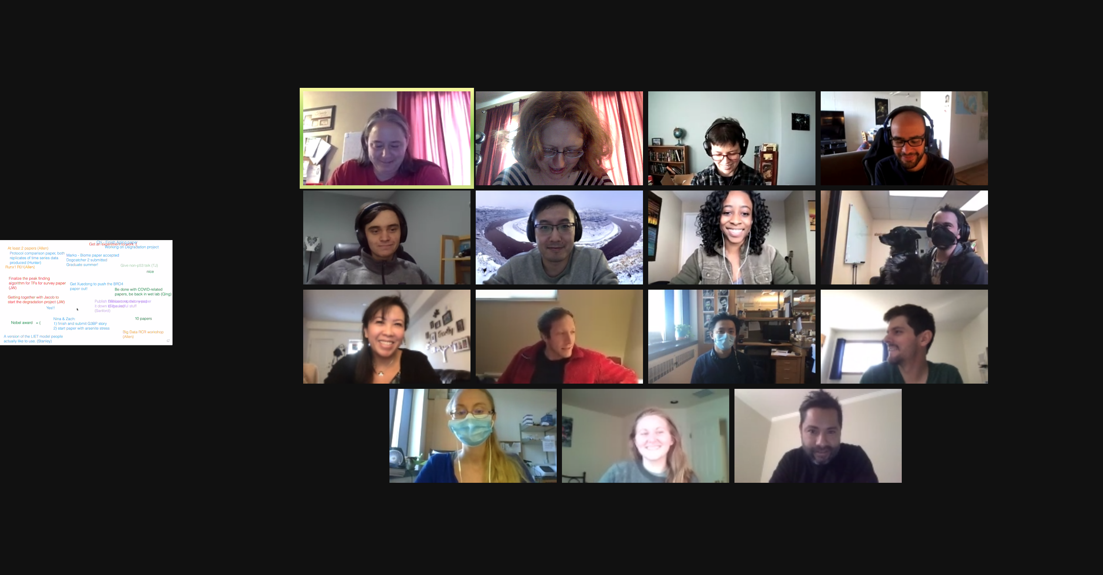
Thank you to the DnA Lab and BIT!!!

Slide 15
Genewiz
Not just for sequencing plasmids

