Slide 1
Short Read Sequencing Analysis Workshop
Day 8 Part 2. Single Cell RNA-Sequencing
In-Class Slides

Slide 2
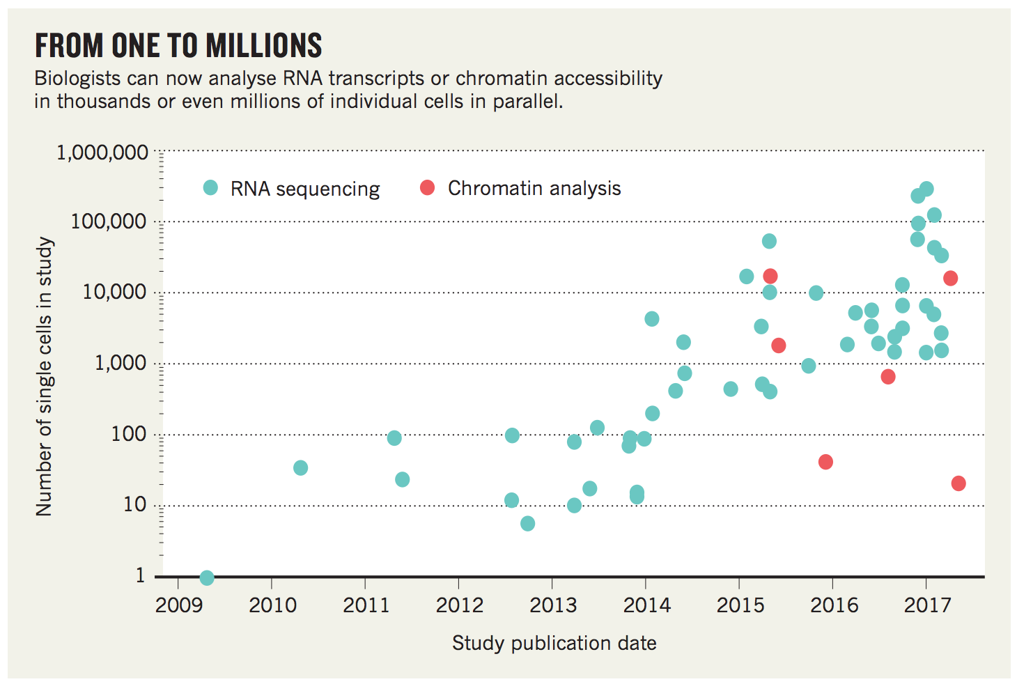
Timeline of scRNA-Seq
https://www.nature.com/news/polopoly_fs/1.22854!/menu/main/topColumns/topLeftColumn/pdf/550451a.pdf

Slide 3
10x Genomics Platform
10x Genomics Training Slides

Slide 4
Library
Sample Index: Experiment
10x Barcode: Droplet (0 or 1 cell)
UMI: Transcript
Expression Matrix
(# transcripts/gene/10x barcode)
Mapping, Counting, etc
https://assets.ctfassets.net/an68im79xiti/3ext0GjeynnDQezv1iRP5u/7b73f52769728575ce696b8f679f82db/CG000204_ChromiumNextGEMSingleCell3_v3.1_Rev_B.pdf

Slide 5
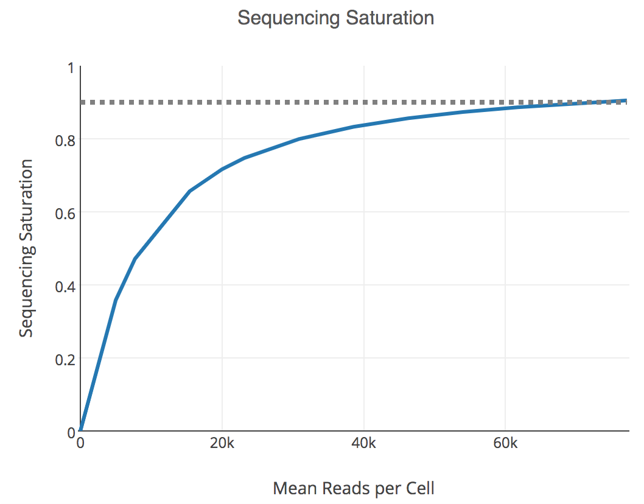
Key Experimental Parameters
# Cells to sequence
Sufficiently large to be able to identify rare subpopulations
Cost is proportional to the number of cells to sequence
Sequencing depth (# reads/cell)
Higher depth -> More chance to detect transcripts
Non-linear relationship.
Benchmark studies showed that saturated at 0.5 M reads/cell
Cost is proportional to the sequence depth
1-P(detect a new transcript)

Slide 6
Analysis Pipeline
Raw Reads
QC
Mapping
Expr. Matrix
QC
Expr. Matrix
transcripts/gene/10x barcode
transcripts/gene/cell
Clustering
Diff. Expr. Genes
DEA
Cluster (Cell Type)
Construction of expression matrix: CellRanger (10x Genomics)
Downstream analysis: CellRanger (10x Genomics), Seurat (Rahul Satija),
Scran (John Marioni), Monocle (Cole Trapnell), Scanpy (Fabian Theis)

Slide 7
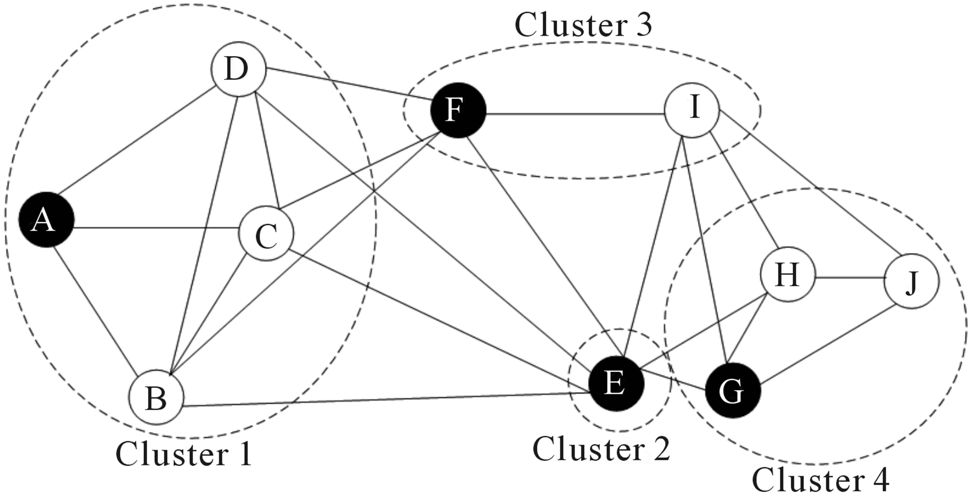
Clustering
k-means
graph-based
https://scrnaseq-course.cog.sanger.ac.uk/website/biological-analysis.html

Slide 8
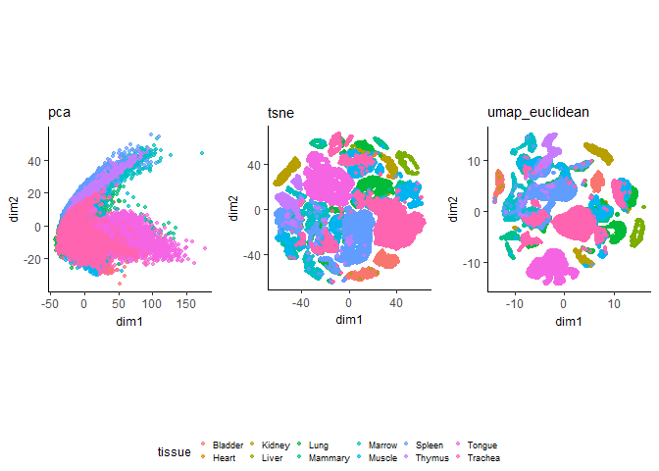
Visualization
http://carbonandsilicon.net/rblogging/2018/02/27/UMAP_plots.html
Notes:
Tabula Muris dataset

Slide 9
Differential Expression Analysis
Bulk RNA-Seq methods (edgeR, DESeq2)
Non-parametric methods
Mann-Whitney U-test
Kolmogorov-Smirnov test
Dedicated methods
MAST
SCDE
Notes:
SCDE: bayesian method, test whether mean are the same

Slide 10
Today’s Tasks
Part 1. Running CellRanger
Part 2. Understanding the outputs of scRNA-seq analysis

Slide 11
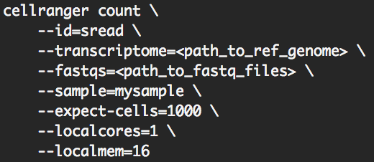
Part 1. Run CellRanger
Copy a sbatch template
Request 1 core, 30 min running time, and 16GB memory
Load cellranger by module load cellranger
Determine the values of the arguments of cellranger count
FASTQ and reference genome are located in the folder /scratch/Workshop/SR2019/8_GATK/singlecellrun
Submit the job

Slide 12
Part 2. Understand the Outputs
Go to /scratch/Workshop/SR2019/8_GATK/singlecelloutput/CellRangerOutput
3 Datasets
Two datasets 1_Ethan_Control and 3_Eric_Control
One aggregate Agg1_EthanEric_ControlsOnly
Transfer the web_summary.html file from each dataset to your local computer
Answer the questions on the worksheet with the information from the files.

