Slide 1
2019 Short Read Sequencing Analysis Workshop Day 7
Quality Control & Nascent Sequencing

Slide 2
Today’s plan
Quality Control (QC)
Pileup, RSeQC, MultiQC
Nascent Analysis
FStitch, Tfit, & DAStk

Slide 3
Before we begin....
Run the following script in the EC2 instance:
$ sh /scratch/Workshop/SR2019/7_nascent/scripts/install_python.sh

Slide 4
Part 1: Quality Control

Slide 5
Data quality affects the type and quality of information that can be obtained from a sequencing experiment
What do we notice about the two samples below?

Slide 6
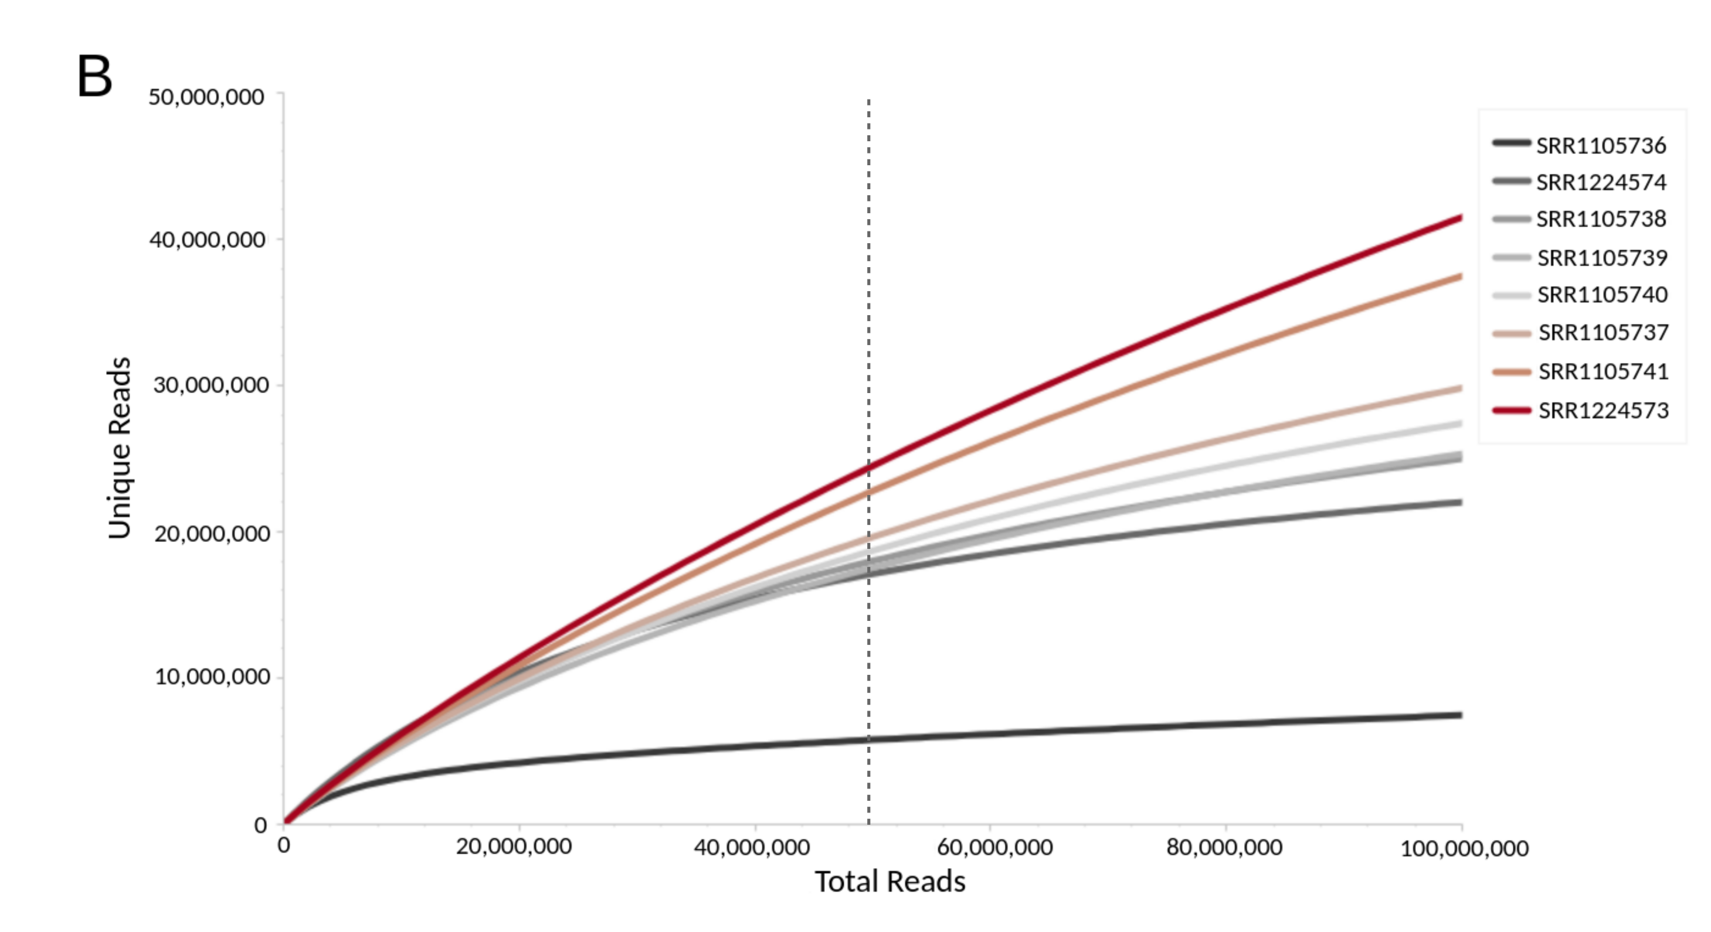
Preseq : Measures data complexity
Complexity = # of unique reads / total reads sequenced

Slide 8
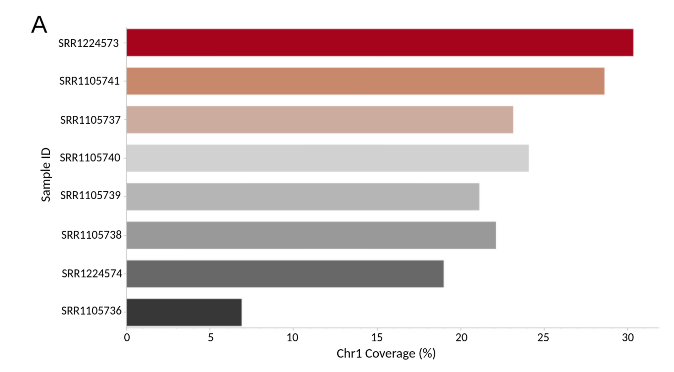
Pileup : Assesses coverage
Coverage = # of base pairs with at least 1 read mapping (not depth)

Slide 9
1. Coverage and complexity are correlative but are NOT the same 2. Increased coverage/complexity does not guarantee better data
Two Important Points

Slide 10
Running FastQC
We've already done this... so this should be a good warm-up!
Copy the script /scratch/Workshop/SR2019/7_nascent/scripts/fastqc.sbatch to your /scratch/Users directory
Run FastQC on the fastq files in the RNA-seq and GRO-seq directories
RNA-seq directory: /scratch/Workshop/SR2019/RNA-seq/fastqs
GRO-seq directory: /scratch/Workshop/SR2019/GRO-seq/fastqs

Slide 11
Running Pileup
Copy the script /scratch/Workshop/SR2019/7_nascent/scripts/pileup.sbatch to your /scratch/Users directory
Edit the pileup.sbatch script and run it on one RNA-seq BAM file and one GRO-seq BAM file
RNA-seq directory: /scratch/Workshop/SR2019/RNA-seq/mapped/bams
GRO-seq directory: /scratch/Workshop/SR2019/GRO-seq/mapped/bams
3. Look at the two *coverage.stats.txt files – what do you notice?

Slide 12
Running RSeQC Read Distribution
Copy the script /scratch/Workshop/SR2019/7_nascent/scripts/read_dist.sbatch to your /scratch/Users directory
Edit the read_dist.sbatch script and run it on one RNA-seq BAM file and one GRO-seq BAM file
RNA-seq directory: /scratch/Workshop/SR2019/RNA-seq/mapped/bams
GRO-seq directory: /scratch/Workshop/SR2019/GRO-seq/mapped/bams
3. Look at the two *read_dist.txt files – what do you notice?

Slide 13
But... what if I have a lot of samples?
It would be nice to be able to view the stats on all of your samples at once....
Fortunately, there's a tool for that: MultiQC
And I already posted the link for it on Day 4:
http://dowell.colorado.edu/ShortRead/sr2019.html#/day4

Slide 14
Running MultiQC
If you kept the scripts formatted the way I had them, you should now have a /scratch/Users/USERNAME/qc directory
In scratch, enter the following lines into your terminal:
$ export PATH=~/.local/bin:$PATH
$ multiqc /scratch/Users/USERNAME/qc -o /scratch/Users/USERNAME/qc/multiqc
NOTE: Because there aren't many files, this is a super quick, low-memory. If it were a larger job, we would run this in the queue

Slide 15
Look at MultiQC html output file in X2Go

Slide 16
Part 2: Generating Annotations/Regions of Interest

Slide 17
Steady-state (RNA-seq)
Nascent (GRO-seq, PRO-seq)
Alternative gene splicing/isoform analysis
Differential expression of steady-state
Post-transcriptional modifications
Exon/intron boundaries
Transcriptional regulatory elements (TREs)
RNA-polymerase activity
Initiation
Pausing
Elongation
Termination
Immediate changes upon permutation

Slide 18
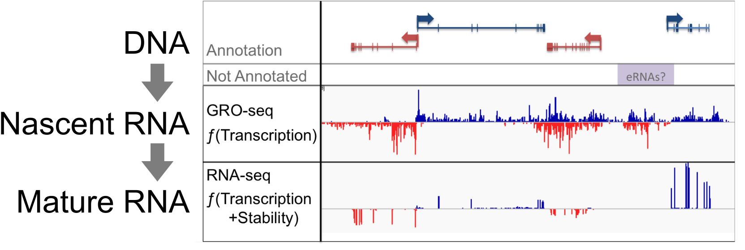
Steady-state vs. Nascent

Slide 19
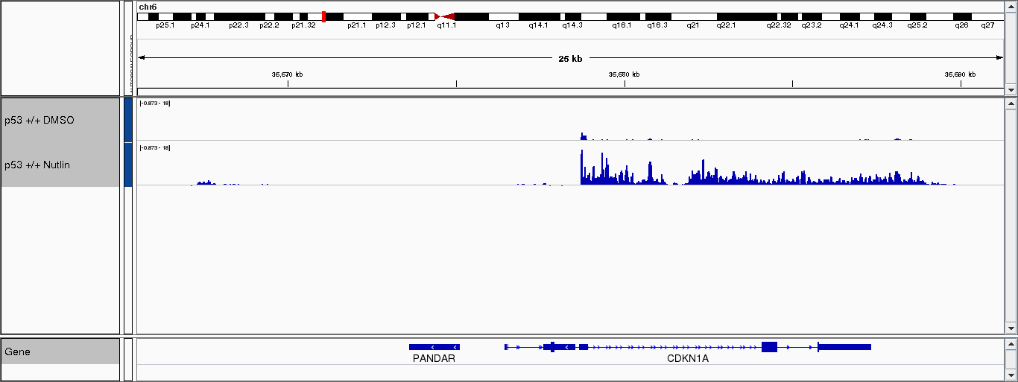
Information Obtained from Nascent Sequencing
Transcription Regulatory Elements (TREs) (orange)
RNAP Pausing Index (red)
3'-end run-on (blue)

Slide 20
Gene annotations are based on mRNA...
Need a way to quickly annotate transcriptional regions of interest

Slide 21
FStitch | Train
Generates model parameters given a set of hand-annotated training regions
1. Look at training file format:
$ less /scratch/Workshop/SR2019/7_nascent/chr1_hct116.bed
2. Log onto X2Go and load IGV:
$ sh /opt/igv/2.3.75/igv.sh
3. Then, in IGV, import our training file:
Regions --> Region Navigator …
4. Choose 3 more "OFF" regions and 3 more "ON" region
Regions --> Export Regions …
5. Edit and run 7_fstitch_train.sbatch script

Slide 22
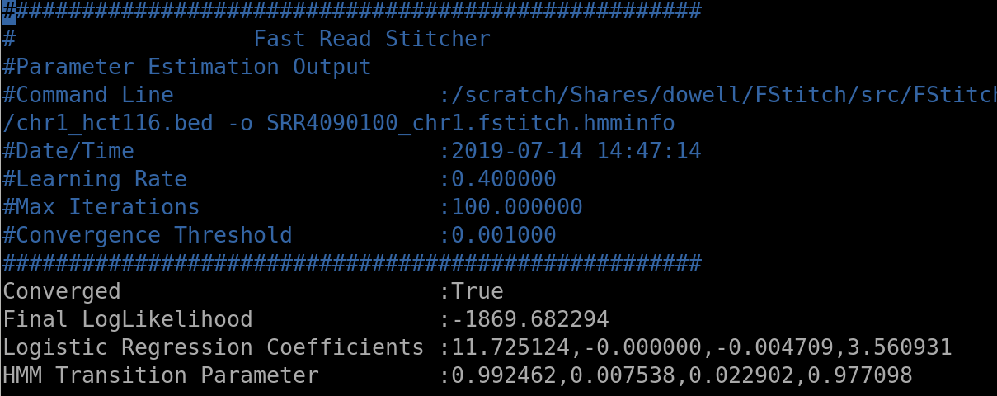
Training File Output

Slide 23
FStitch | Segment
Given the model parameters, segment the genome into active ("ON") and inactive ("OFF") regions of transcription
1. Edit and run 7_fstitch_segment.sbatch script
2. When the job is complete, look at segment data in IGV

Slide 24
FStitch | Bidir
Using FStitch segment output and a gene annotation file, we can now parse bidirectionals (active regions of RNAP loading)
1. Edit and run 7_fstitch_bidir.sbatch script
2. When the job is complete, look at bidirectional annotations in IGV

Slide 25
Applications of FStitch Output
Differential transcription analysis of genes/bidirectionals

Slide 26
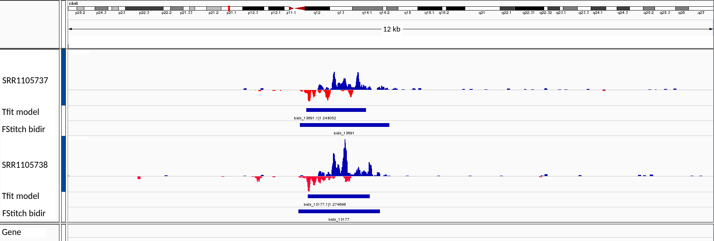
Applications of FStitch Output
Pre-filter to Tfit (a tool that models RNAP behavior)

Slide 27
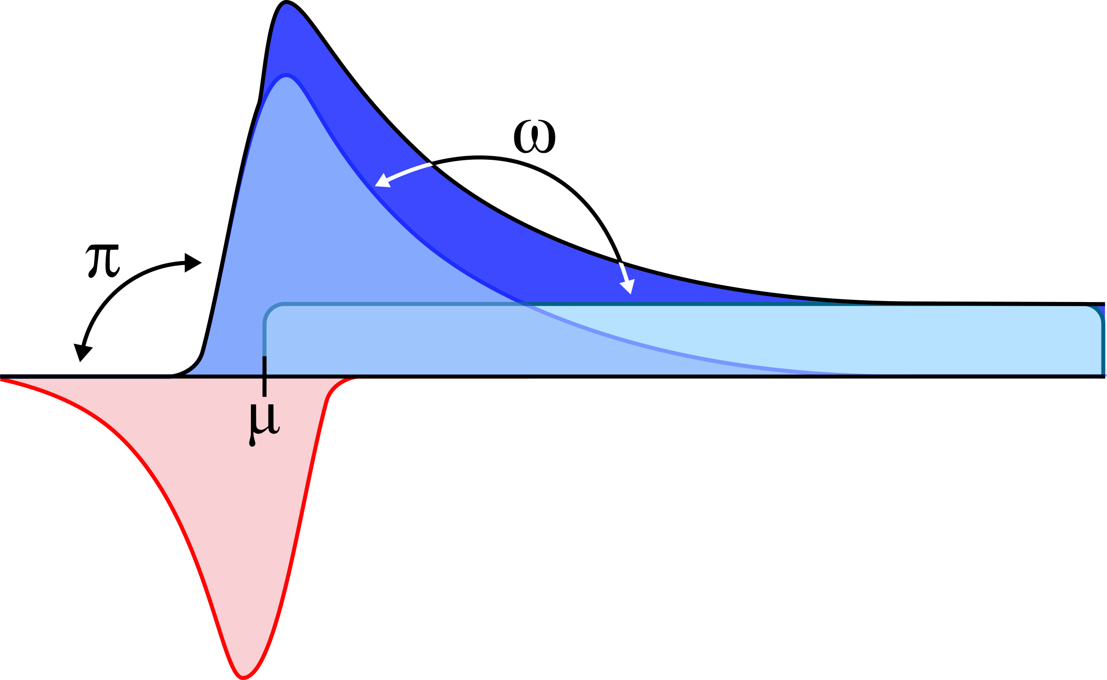
Tfit Model Cartoon

Slide 28
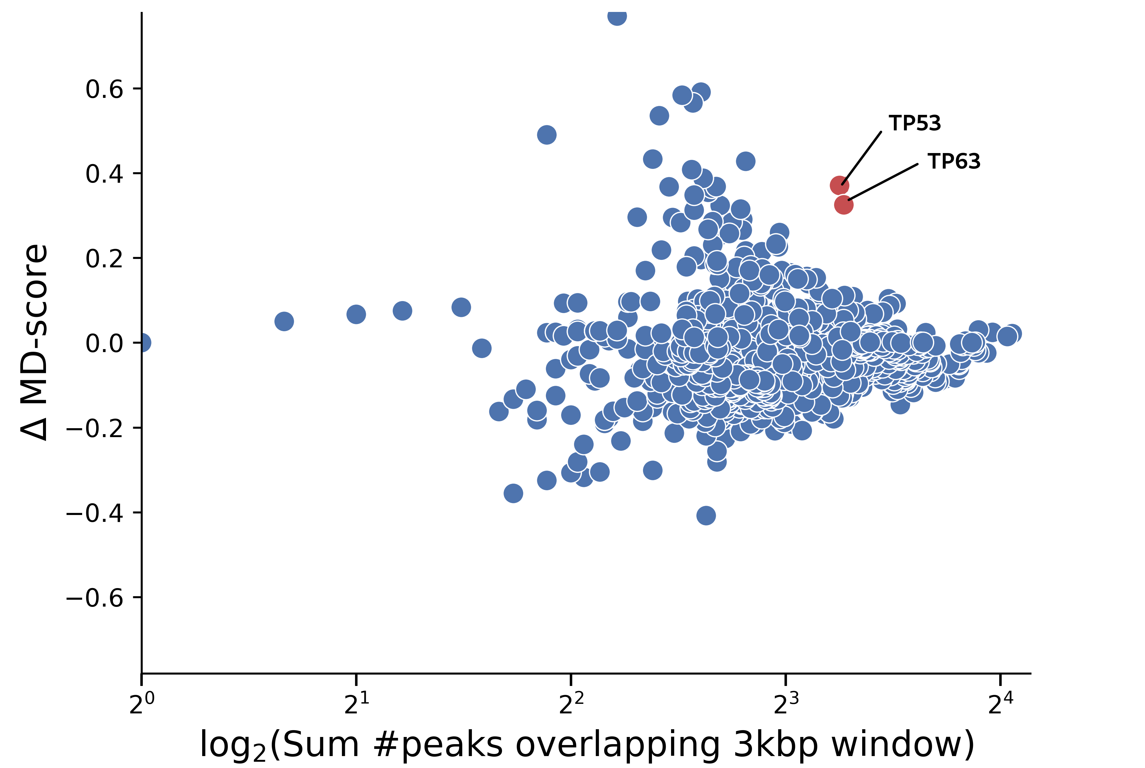
Motif Displacement Analysis
Generate a "metagene" using the annotations
Calculate the ratio of the number of motifs within 300bp from the center of each annotation to those found within 3000bp
Determine whether the change in MD score is statistically significant

Slide 29
Homework
Run QC on ChIP and ATAC and compare this data to RNA-seq and GRO-seq
Use the scripts provided to calculate MD scores using Tfit annotations
If you are struggling, keep in mind we will get more practice with this on Day 9/10

Slide 30
The End
Questions??
Don’t forget the homework.
Help session in JSCBB A108 from 1-3pm
Watch videos for Day 8

