Slide 1
2019 Short Read Sequencing Analysis Workshop Day 6
RNA-seq: Differential gene expression analysis

Slide 2
What do we need for Differential Expression Analysis?
PREVIOUSLY…
(featureCounts)

Slide 3
A even closer look at what’s inside of “counts”
PREVIOUSLY…
Let’s check the first 2 lines of the count table:
> head(count_matrix$counts, n=2L)
Those are really long sample names!
X.scratch.Workshop.SR2019.6_RNA.seq.mapped.bams.SRR4098426_chr1.sorted.bam
XM_011541469.1 0
XM_011541467.1 0
X.scratch.Workshop.SR2019.6_RNA.seq.mapped.bams.SRR4098427_chr1.sorted.bam
XM_011541469.1 0
XM_011541467.1 0
X.scratch.Workshop.SR2019.6_RNA.seq.mapped.bams.SRR4098428_chr1.sorted.bam
XM_011541469.1 0
XM_011541467.1 0
X.scratch.Workshop.SR2019.6_RNA.seq.mapped.bams.SRR4098429_chr1.sorted.bam
XM_011541469.1 0
XM_011541467.1 0
We can replace those sample names with something more descriptive:
> colnames(count_matrix$counts) <- sample_ID

Slide 4
Statistical assumptions…
The expression level of most loci are not changing, i.e. the average log fold change is approximately zero.
The variance of the counts for any loci can be modeled by the negative binomial distribution, i.e. variance is proportional to the square of the mean. For a given loci:
$$Var=μ+α⋅μ^{2}$$
where $μ$ is the average expression level of the gene and $α_{i}$ is the dispersion factor (we will return to this)

Slide 5
Load counts data and define experimental conditions
You can look at the contents of your workspace:
Define the conditions for each sample and put it all together in a data frame:
Check to make sure the data files and IDs correspond to the correct experimental conditions:

Slide 6
Convert your counts table into a DESeq data set
Load the DESeq2 library:
Compile the counts, experimental conditions table and the design matrix into a DESeqDataSet:
Check that its dimensions, row names, and column names are correct:

Slide 7
Filter out non-informative loci
Loci that have no count data are uninformative and so can be removed. Here you see the counts are zero for the first rows:
These can be filtered out as follows (use nrows() to check how many rows are removed):
Now you can see at least one of the samples contains some counts for each row:

Slide 8
Main computation/fitting
Now that your DESeqDataSet object contains all the necessary information, you can run the main function to compute the model fit:
Once complete, you can look at a summary of all the data it contains. The row, column, and count data is transferred from the input data object:

Slide 9
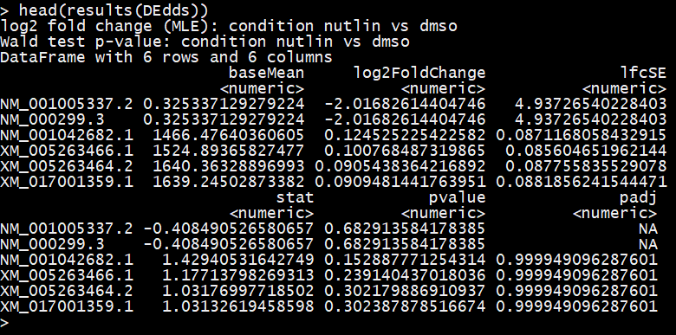
Contents of the results
Mean counts for control condition
Log fold change
Uncertainty on log fold change
Value of statistic (Wald test) for calculating p-value
adjusted p-value
p-value

Slide 10
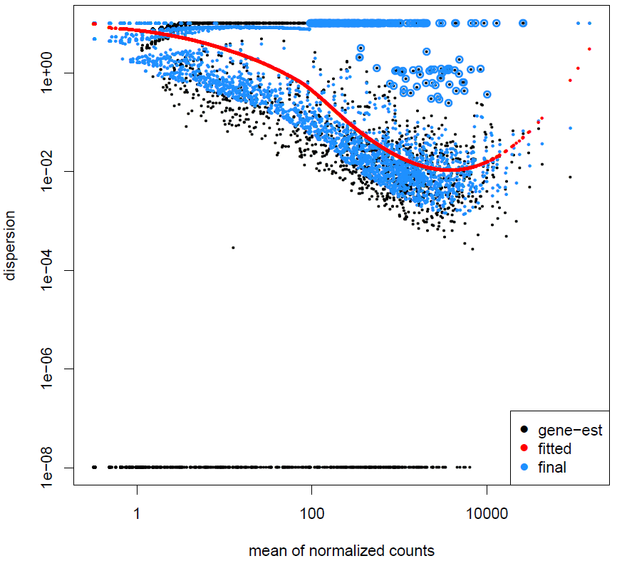
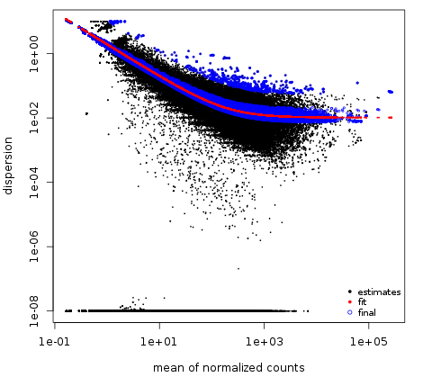
Estimating dispersion ($α$)
Our samples for today (2 replicates per condition) do not follow this trend:
DESeq2 assumes the estimated dispersion follows a power law:
$$α(\overline{μ})= \frac{a}{\overline{μ}}+μ_{0}$$

Slide 11
Set significance threshold and extract results
In order to extract your significant results, you must specify your significance threshold ($α$) and indicate what are the treatment and control conditions:
The results() function will then identify the values for the given threshold and comparison:
Log fold shrinkage reduces the large variance in log-fold change for loci with low counts. This is done primarily for the purpose of visualization. It does not change the significance of any loci

Slide 12
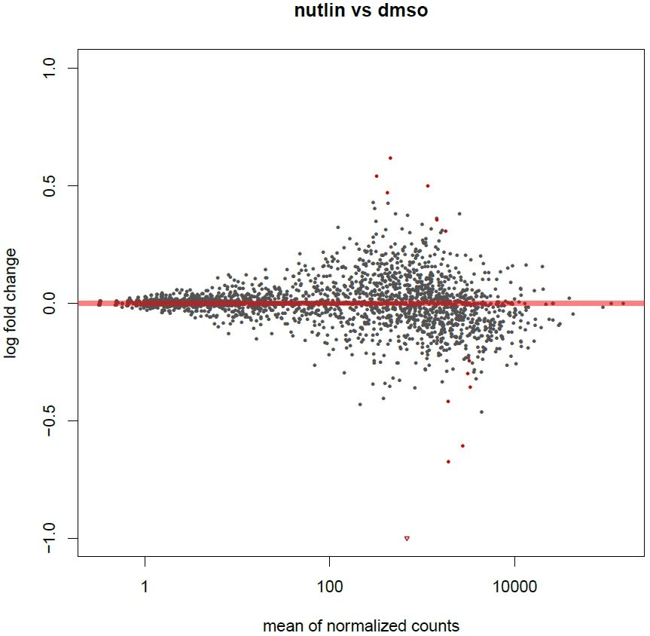
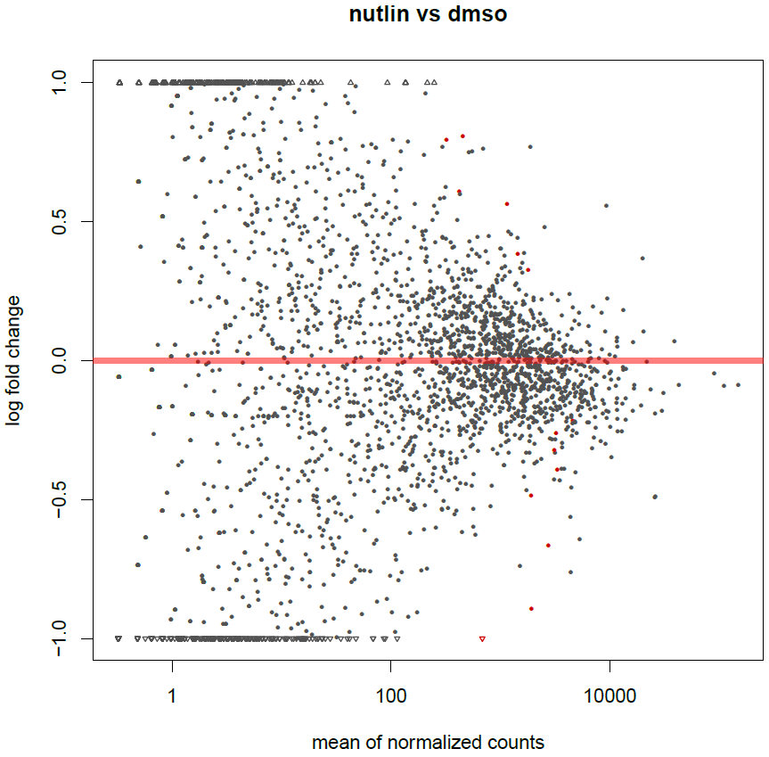
MA plotting
after shrinkage adjustment
The cluster of non-significant loci should be centered at zero.
Red points indicate loci that were determined to be significant
Log fold change shrinkage reduces those loci estimated to have too great of fold change (does not affect calculation of significance)

Slide 13
Saving your results
Sort the results by adjusted p-value and only select those that are below the chosen alpha value threshold:
These significant results can then be written to a csv file, which can be opened in excel:

Slide 14
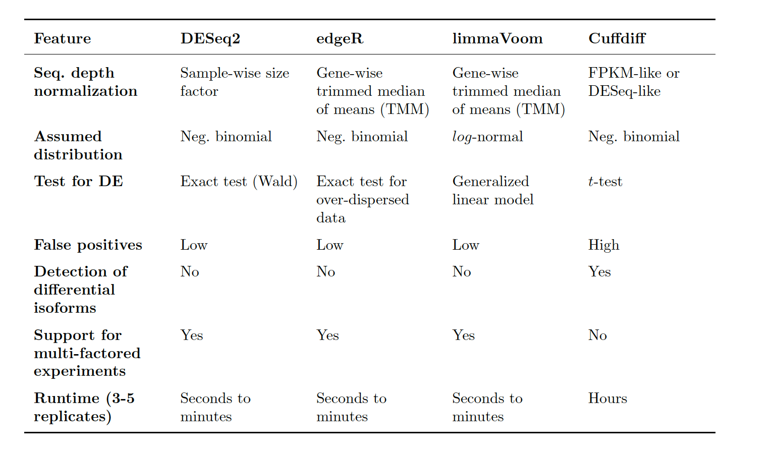
Other methods are available:

Slide 15
General advice:
Emphasize more replicates rather than deeper sequencing per replicate (results in better estimation of variance)
There is no one perfect tool for differential expression analysis
For robust results, use multiple methods and look at the loci they have in common
Look at your data (MA plot, dispersion estimates, etc.)

