Slide 1
Day 4: QC and Trimming

Slide 2
Itinerary:
View your “generated” FASTQ Files
Determine the quality of our sequences
Remove poor quality or unaffiliated reads
Confirm that the libraries are of high enough quality for mapping

Slide 3
FASTQ example on terminal
Change your directory to the one containing your fastq files:
cd /scratch/Workshop/SR2019/4_qc/fastq
Use a command to look at the fastq file (more, less, head… NOT VIM)
DON’T USE A TEXT EDITOR ON FASTQ FILES! These should always remain untouched, they are your raw data!
more SRR5855054_chr1.fastq
(Note: you don’t HAVE to change your working directory each time! How would you view it without changing your directory?)

Slide 4
Let’s Practice!
Locate the FASTQ file SRR5855054_chr1.fastq located in /scratch/Workshop/SR2019/4_qc/fastq
View it using one of the commands you learned on Tuesday. Don’t use a text editor!

Slide 5
FASTQ breakdown
Line one: Read ID (@, followed by descriptor)
Line two: Sequence
Line three: + (and optional descriptor)
Line four: Quality score (Usually Phred-33, but double check with your sequencing facility if unsure)
What info is there in a FASTQ file? How do we know if the library is of good quality?

Slide 6
https://www.google.com/url?sa=i&source=images&cd=&ved=2ahUKEwjd2uHPqavjAhUZOs0KHceiA58QjRx6BAgBEAQ&url=https%3A%2F%2Fmedium.com%2Fnyc-design%2Fgigo-garbage-in-garbage-out-concept-for-ux-research-7e3f50695b82&psig=AOvVaw0wgsJgdz7E8hBUge3oTag-&ust=1562881542342529

Slide 7
FastQC: Summarizes info about FASTQ files
GC Content (Is the library contaminated?)
Adaptor Content (Did the sequencer read into our adaptors?)
Read Duplication (Is our sample overamplified? Depends on library type…)
Sequence Quality/N content (How confident was the sequencer in calling each base?)
Sequence Quality based on flow cell location (Was there a sequencing failure?)
Base Identity at each location (Was there any bias in amplification/ligation?)

Slide 8
Running FastQC:
Fill out SBATCH script info
module load fastqc (makes it so we can execute FastQC from our working directory)
fastqc /path/to/file -o /path/to/outdir
Let’s look at the output!

Slide 9
FastQC outputs an html file… how do we view it? Just send it back to your local computer:
Logout of your instance:
logout
Send the file to your local computer:
rsync -r user@remote.host:/path/to/fastqc/outdir/ /path/to/local/storage/
Open the HTML file with your preferred browser

Slide 10
Let’s Practice!
Make a subdirectory in your /scratch/Users/your_name directory for FastQC output and one for your scripts.
Copy the 4_fastqc.sbatch script to your new directory (from /scratch/Workshop/SR2019/scripts).
Edit the SBATCH headers, and the output directory
Run FastQC on the file SRR5855054_chr1.fastq located in /scratch/Workshop/SR2019/4_qc/fastq. Output the files to your /scratch/Users/your_name/FastQC directory
Send the output to your computer to view it

Slide 11
Use your favorite browser to view FastQC output file
Open the HTML file using Firefox, Chrome, Safari, etc.

Slide 12
So we have a library… how do we clean it up?
Get rid of…
Low quality reads
Adaptor content
Reads that are too small (these won’t map well)
Library specific (not today, but you may encounter it in your own sequences):
“Flip” the reads
Remove poly-A reads

Slide 13
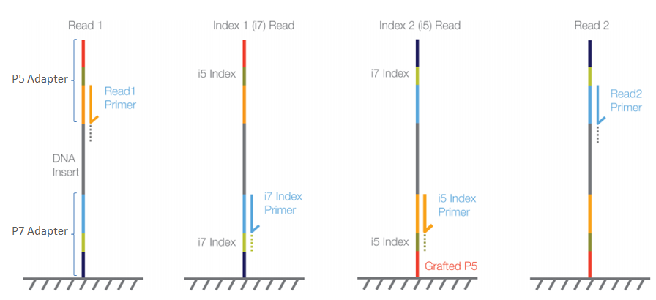
https://support.illumina.com/bulletins/2016/04/adapter-trimming-why-are-adapter-sequences-trimmed-from-only-the--ends-of-reads.html

Slide 14
Trimming tools:
Trimmomatic- Java-based. Quick, easy, handles PE reads. Dated, not a lot of customization options (We’ll use this today, but feel free to find your own!)
BBduk- Rapid, many customization options, handles PE reads, can be parallelized, detailed summary report (our lab’s favorite!)
Cutadapt- Python-based. Easy to use. won’t handle PE reads, no parallel processing, lacking detailed summary report.
TrimGalore, SeqTrim, ngsShoRT, etc…
Each has strengths and weaknesses, compare a couple to find your best fit

Slide 15
Trimmomatic:
module load trimmomatic
java -jar /opt/trimmomatic/0.36/trimmomatic-0.36.jar SE -threads 8 -phred33 -trimlog /path/to/trimlog.log /path/to/input/fastq /path/to/output/trimmed.fastq \
ILLUMINACLIP:/path/to/adapter/fasta:2:30:10 SLIDINGWINDOW:3:20 LEADING:33 TRAILING:33 MINLEN:36
The bottom section are customizable options for different quality/trimming thresholds you may want to set

Slide 16
ILLUMINACLIP: Cut adapter and other illumina-specific sequences from the read.
Note the format- ILLUMINACLIP:<filepath>:<max mismatches>:<read/adaptor similarity threshold>:<minimum adapter length to trigger trimming>
SLIDINGWINDOW: Performs a sliding window trimming approach. It starts scanning at the 5’ end and clips the read once the average quality within the window falls below a threshold.
LEADING: Cut bases off the start of a read, if below a threshold quality TRAILING: Cut bases off the end of a read, if below a threshold quality
CROP: Cut the read to a specified length by removing bases from the end HEADCROP: Cut the specified number of bases from the start of the read MINLEN: Drop the read if it is below a specified length
And more: http://www.usadellab.org/cms/?page=trimmomatic

Slide 17
We’ll trim our reads… how do we know if the trimming worked?
Look at the trimlog (and err/out files)
more /path/to/trimlog
Hard to interpret, right?
2. Run FastQC again, this time on the trimmed file (I usually lump this in with the Trimmomatic script)
module load fastqc
fastqc /path/to/file -o /path/to/outdir

Slide 18
Let’s Practice!
Copy the 4_trimmomatic.sbatch script to your user directory
Make a new directory: /scratch/Users/your_name/trimmomatic
Change the headers in your script, and the output directory
Write the script so that it runs trimmomatic on SRR5855054_chr1.fastq. Output the files to your new trimmomatic directory
In that same script, run FastQC on the output file. Run your script on the cluster
When it’s finished, send the output of FastQC to your local computer and view it

Slide 19
Trimmomatic for paired end reads (for homework!):
module load trimmomatic
java -jar /opt/trimmomatic/0.36/trimmomatic-0.36.jar PE -threads 8 -phred33 -trimlog /path/to/trimlog.log /path/to/input/fastq1 /path/to/input/fastq2 /path/to/trimmed/paired.output1.fastq /path/to/trimmed/unpaired.output1.fastq /path/to/trimmed/paired.output2.fastq /path/to/trimmed/unpaired.output2.fastq \
ILLUMINACLIP:/path/to/adapter/fasta:2:30:10 SLIDINGWINDOW:X LEADING:X TRAILING: X CROP:X MINLEN:X
The bottom section is a list of customizable options for different quality/trimming thresholds you may want to set

Slide 20
Up Next: Mapping our reads...

