Slide 1
Short Read Sequencing
Analysis Workshop
Day 1
Considerations for Sequencing

Slide 2
What is short-read sequencing?
VS
50-250bp
10-50kb or more

Slide 3
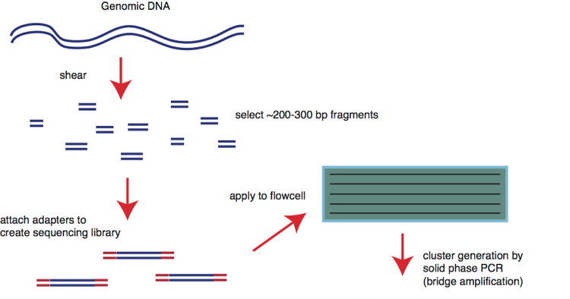
How does Illumina sequencing work?
Library generation and affixing library to flow cell
http://bitesizebio.com/13546/sequencing-by-synthesis-explaining-the-illumina-sequencing-technology/

Slide 4
Anatomy of a library
P5 and P7 ends of adapters bind to flow cell
DNA insert typically ranges 200-600 bp (<1kb)
Different methods of indexing
  Inline (part of the insert) – any level of multiplexing
  Single index read (≤96)
  Dual index reads (384+)

Slide 5
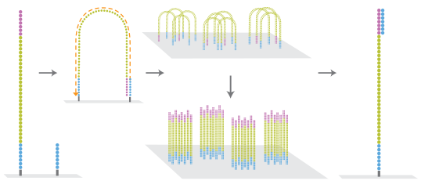
How does Illumina sequencing work?
Cluster Generation

Slide 6
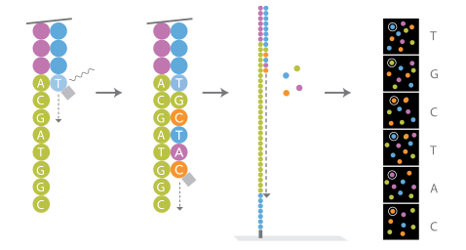
How does Illumina sequencing work?
Sequencing by synthesis
with reversible terminators

Slide 7
How does Illumina sequencing work?

Slide 8
Output: Millions of short read sequences
Read 1
ATCGACGGTTAACTGATCG…
ATGCGTGCTGCAGTGCCAC…
CGTGGACCAAATGGCACAT…
CTGTGAAACAATTGGGGAT…
ATGCGTGCTGCAGTGCCAC…
ATCGACGGTTAACTGATCG…
ATGCGTGCTGCAGTGCCAC…
CGTGGACCAAATGGCACAT…
CTGTGAAACAATTGGGGAT…
ATGCGTGCTGCAGTGCCAC…
ATGCGTGCTGCAGTGCCAC…
ATCGACGGTTAACTGATCG…
ATGCGTGCTGCAGTGCCAC…
CGTGGACCAAATGGCACAT…
CTGTGAAACAATTGGGGAT…
ATGCGTGCTGCAGTGCCAC…
Index Read 1 (i7)
TCAGTGCT
ACGTTCTA
TCAGTGGG
CTCGGCGA
ACGTTCTA
TCAGTGCT
ACGTTCTA
TCAGTGGG
CTCGGCGA
ACGTTCTC
ACGTTCTA
TCAGTGCT
ACGTTCTA
TCAGTGGG
CTCGGCGA
ACGTTCTC
Index Read 2 (i5)
ACGTTCAT
CAACGTTC
ATTCAGTG
GCCTCGGC
CAACGTTC
ACGTTCAT
CAACGTTC
ATTCAGTG
GCCTCGGC
CAACGTTC
CAACGTTC
ACGTTCAT
CAACGTTC
ATTCAGTG
GCCTCGGC
CAACGTTC
Read 2
CTGGTGACAACTGATGCTT…
TGACCATTGGGTACAACCC…
CCAGTGAACGTGAGCAAGT…
GGTTGACCATTGGGGTGAC…
TGACCATTGGGTACAACCC…
CTGGTGACAACTGATGCTT…
TGACCATTGGGTACAACCC…
CCAGTGAACGTGAGCAAGT…
GGTTGACCATTGGGGTGAC…
TGACCATTGGGTACAACCC…
TGACCATTGGGTACAACCC…
CTGGTGACAACTGATGCTT…
TGACCATTGGGTACAACCC…
CCAGTGAACGTGAGCAAGT…
GGTTGACCATTGGGGTGAC…
TGACCATTGGGTACAACCC…

Slide 9
Demultiplexing
Read 1
ATCGACGGTTAACTGATCG…
ATGCGTGCTGCAGTGCCAC…
CGTGGACCAAATGGCACAT…
CTGTGAAACAATTGGGGAT…
ATGCGTGCTGCAGTGCCAC…
ATCGACGGTTAACTGATCG…
ATGCGTGCTGCAGTGCCAC…
CGTGGACCAAATGGCACAT…
CTGTGAAACAATTGGGGAT…
ATGCGTGCTGCAGTGCCAC…
Index Read 1 (i7)
TCAGTGCT
ACGTTCTA
TCAGTGGG
CTCGGCGA
ACGTTCTA
TCAGTGCT
ACGTTCTA
TCAGTGGG
CTCGGCGA
ACGTTCTC
Index Read 2 (i5)
ACGTTCAT
CAACGTTC
ATTCAGTG
GCCTCGGC
CAACGTTC
ACGTTCAT
CAACGTTC
ATTCAGTG
GCCTCGGC
CAACGTTC
Read 2
CTGGTGACAACTGATGCTT…
TGACCATTGGGTACAACCC…
CCAGTGAACGTGAGCAAGT…
GGTTGACCATTGGGGTGAC…
TGACCATTGGGTACAACCC…
CTGGTGACAACTGATGCTT…
TGACCATTGGGTACAACCC…
CCAGTGAACGTGAGCAAGT…
GGTTGACCATTGGGGTGAC…
TGACCATTGGGTACAACCC…
Current Illumina kits allow up to 384 unique indexes to be pooled

Slide 10
Demultiplexing
Read 1
ATCGACGGTTAACTGATCG…
ATGCGTGCTGCAGTGCCAC…
CGTGGACCAAATGGCACAT…
CTGTGAAACAATTGGGGAT…
ATGCGTGCTGCAGTGCCAC…
Index Read 1 (i7)
TCAGTGCT
ACGTTCTA
TCAGTGGG
CTCGGCGA
ACGTTCTA
Index Read 2 (i5)
ACGTTCAT
CAACGTTC
ATTCAGTG
GCCTCGGC
CAACGTTC
Read 2
CTGGTGACAACTGATGCTT…
TGACCATTGGGTACAACCC…
CCAGTGAACGTGAGCAAGT…
GGTTGACCATTGGGGTGAC…
TGACCATTGGGTACAACCC…
Sample 1
Read 1 Read 2
ATCGACGGTTAACTGATCG… CTGGTGACAACTGATGCTT…
CGTGGACCAAATGGCACAT… CCAGTGAACGTGAGCAAGT…
Sample 3
Read 1 Read 2
CTGTGAAACAATTGGGGAT… GGTTGACCATTGGGGTGAC…
Sample 2
Read 1 Read 2
ATGCGTGCTGCAGTGCCAC… TGACCATTGGGTACAACCC…
ATGCGTGCTGCAGTGCCAC… TGACCATTGGGTACAACCC…

Slide 11
Different types of sequencing libraries
Whole genome sequencing
RNA Sequencing/GRO-Seq
ChIP-seq
DNAse 1, ATAC-seq
Exome sequencing
Methyl-Seq
Metagenomic/Amplicon (low diversity)

Slide 12
What type of library is best for you?
Ligation-based
  Genomic (WGS)
    PCR based
    PCR-free
  Standard RNA-Seq
    RNA-ligation (small RNA)
    DNA-ligation
  ChIP-Seq
  ddRAD/RAD-seq*
PCR-based
  Amplicon (eg. 16s)
  Custom target methods
  Tag-seq (RT + template switching)
“Tagmentation”
  Genomic
  Long amplicon
    Lose 50bp on ends of amplicon
  ATAC-seq
Notes:
Figure ~ 15 minutes to go through all of these – explain what they look like, show how they are constructed and typical sizes. Make handout with a single page overview for people to reference later – or have a second computer to have that up on a slide

Slide 13
What to do with the data?
Short Read Sequencing
Assembly
Quality Metrics & Trimming
Align to reference genome
Variant Calling
Expression/Read Depth
Alternative splicing
Peak/Region identification
Metagenomics

Slide 14
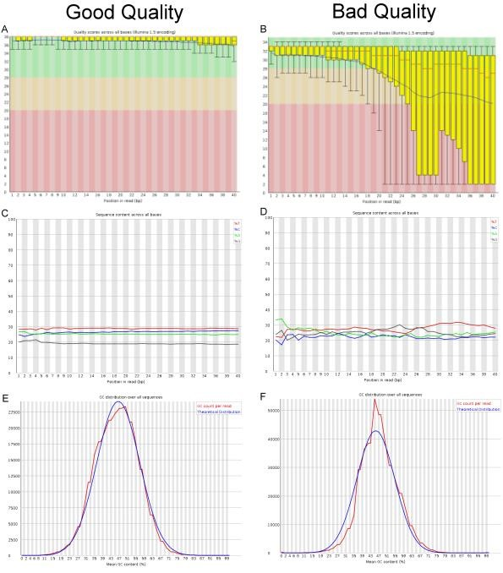
Quality Assessment & Trimming
Pinpoint problems with library prep/sequencing
Identify possible biases
Improve mapping through trimming

Slide 15
Align to reference genome
Reference
Chr1 1000-2500
Sample 1 reads
Sample 3 reads
Sample 2 reads
Bowtie2
Tophat2
BWA

Slide 16
Variant Calling
Reference
Chr1 1000-2500
A
C
C
C
C
C
C
C

Slide 17
Differential Expression
Reference
Chr1 1000-2500

Slide 18
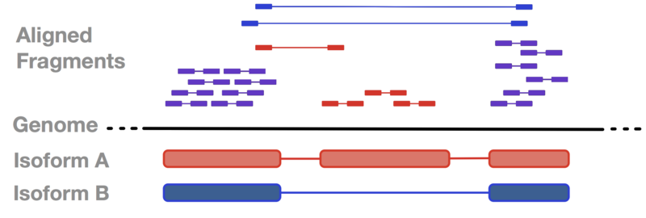
Alternative Splicing

Slide 19
Peak/Region identification
Reference
Chr1 1000-2500
Peak

Slide 20
Experimental Design considerations
Genome Size
Read Length
Sequencing Depth
# of Replicates
Single-end vs. Paired-end
Insert Size

Slide 21
Coverage & Read-depth
Coverage = estimate of average number of reads covering a single base
Avg Coverage = (# reads) x (read length)
size of genome
Reference
Depth
D
E
P
T
H

Slide 22
Coverage and read length considerations
Genomic DNA
RNA-seq
Read Length:
  Any, but longer reads are best (2x150)
Replicates:
  Not routinely performed
Coverage:
  Typical variant calling – 30X coverage in diploids
  Rare variants – 100X coverage
  Skim-seq – 5X coverage
  Shotgun Metagenomic – depends on diversity of sample 20-200M reads
Read Length:
  1x50/1x75 for differential expression
  2x75 or 2x150 for alternative splicing
Replicates:
  At least 3 biological
  Replicates trump read numbers
Coverage/reads:
  Human/Mouse/Rat
    Gross differential expression: 20-30M reads
    Alternative splicing, lowly expressed RNAs: >60M reads

Slide 23
Coverage and read length considerations
ChIP-seq/ATAC-seq
Amplicon sequencing
Use ENCODE standards!
  https://www.encodeproject.org/chip-seq/
Read Length:
  1x50, 1x75, 2x37
Replicates/Controls:
  Input gDNA or IgG control for each sample/treatment
  2 biological replicates are sufficient
Coverage/Reads:
  Depends on the target
  Histone: 10-20M
  TF: >10M
Read length:
  Depends on the amplicon
Replicates:
  Depends on the experimental design
Coverage/reads:
  Amplicon testing/screen: 100X per target
  Metagenomic: Depends on complexity of population
    Check out the Earth Microbiome Project

Slide 24
What that means in reads...
30X Coverage with 2 x 150 bp reads
  For E. coli, ~4.6 Mb
    138 Mbp, 0.46 Million reads
    ~3% of a MiSeq run
  For Human, ~3.2 Gb
    96 Gbp, 320 Million reads
    80% of a NextSeq High Output run or 1.3 lanes of HiSeq 2500 run

Slide 25
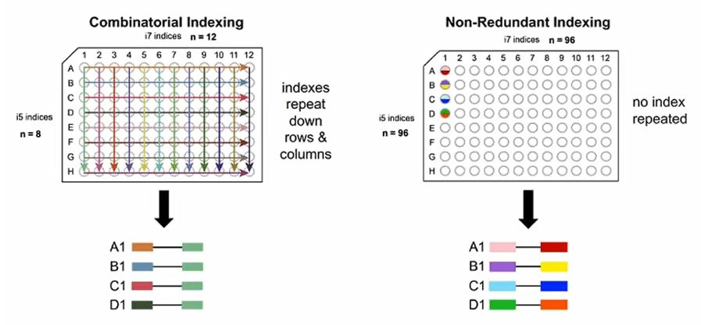
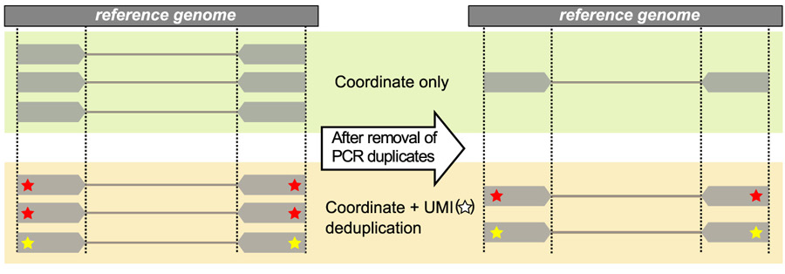
Library indexing considerations
Single 6bp indexing
  Good for a small number of samples (<24)
  Index hopping may be an issue
Combinatorial-Dual (CD) indexing
  Being phased out, good for <384 samples. Index hopping may be an issue.
Unique-Dual indexing (UDI)
  AKA, non-redundant indexing
  Best indexing to avoid index hopping
Unique Molecular Identifiers (UMI)
  Unique tags for each molecule in the library
  Reduces false discovery in variant calling
  Reduces/Eliminates PCR bias

Slide 26
Other considerations
Base diversity (at each position)
Custom versus kitted libraries – kit biases
PCR/PCR-free libraries
How unique is the run-type you want
Queue times/Data delivery times
Many more....

Slide 27
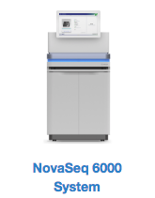
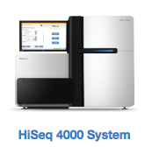
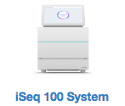
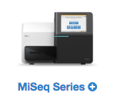
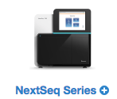
A variety of Illumina sequencing platforms
 | iSeq 100 | MiSeq | NextSeq | HiSeq 4000 | NovaSeq
Run time | 9-17.5 hr | 9-55hr | 12-30hr | 1-3.5 days | 13-44hrs
Throughput | 1.2GB | 7.5-15Gb | 120Gb | 1500Gb | 6000Gb
Read output | 4M | 12-25M | 130-400M | 6B | 20B
Color system | 1 channel | 4 channel | 2 channel | 4 channel | 2 channel
Flowcell | Patterned | Non-Patterned | Non-Patterned | Patterned | Patterned

Slide 28
Platform Comparison - Imaging
1 & 2 channel chemistry:
Advantages: Much faster (only 2 images) & less storage
Disadvantages: Sensitive to low diversity
iSeq imaging: no more photos!
Illumina cmos tech note (770-2013-054B)

Slide 29
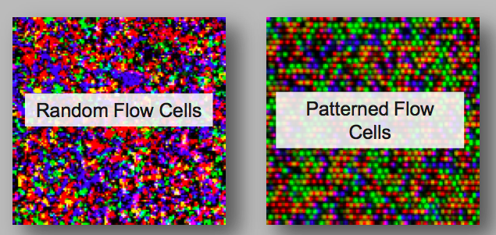
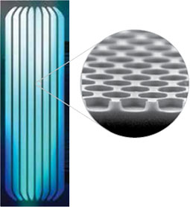
Platform Comparison - Flowcells
Patterned
  Ordered Nanowells – clustering occurs only in nanowells
  Exclusion Amplification
  Increases throughput
  But, very sensitive to loading concentration, fragment size distribution, INDEX HOPPING

Slide 30
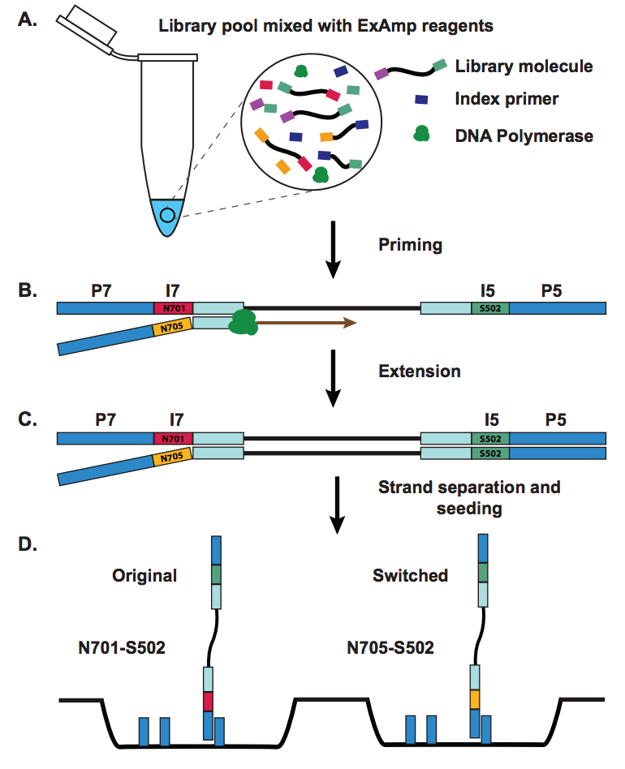
What is index hopping?
What is index hopping?
Index hopping occurs when free floating adaptor acts as a primer during cluster amplification, causing index miss-assignment.
When should I worry about it?
When using patterned flow-cells, particularly when you are looking for rare variants or transcripts or when doing low-pass sequencing.
How do I prevent it?
Remove free floating adapter from library pool. Use non-redundant indexes.
Sinha, R., et al. 2017. Index Switching Causes “Spreading-Of-Signal” Among Multiplexed Samples In Illumina HiSeq 4000 DNA Sequencing. bioRxiv. DOI: 10.1101/125724

Slide 31
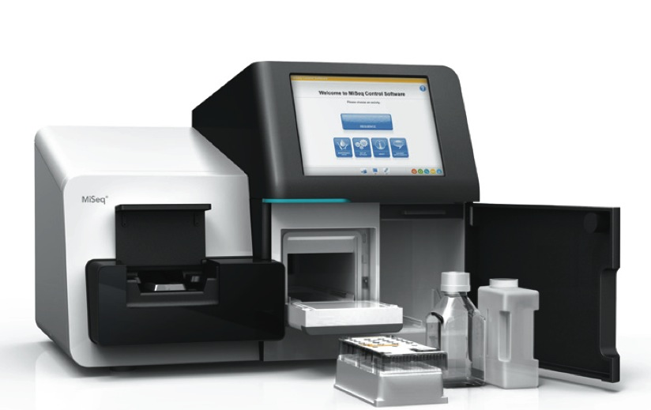
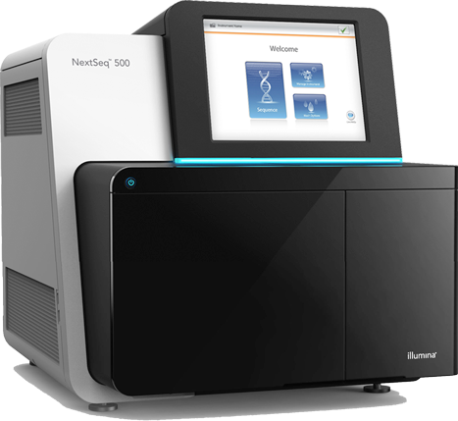
Which Sequencer should I use?
MiSeq
  15-25 M reads/run
  1x50 to 2x300
  $$$/bp
  Amplicon &QC sequencing
NextSeq
  130-500 M reads/run
  1x75 to 2x150
  $$/bp
NovaSeq6000
  650M-10B reads/run
  2x50 to 2x250*
  $/bp

Slide 32
Questions?
Other questions email biof-ngs@colorado.edu

