Slide 2
Library QA & QC
Day 1, Video 3
Experimental considerations for library construction
Considerations for input material
Quantification by Qubit
Quality control by Bioanalyzer
Quantification and quality control by qPCR

Slide 3
Experimental considerations
Single read vs. Paired end reads
Read length
Sequencing Depth/Coverage
Replicates
These will direct you to a specific platform
MiSeq: 15-25M clusters per run, 50-300bp read length
HiSeq v3: 150-200M clusters per lane, 50-100bp read length
Coverage = bp Sequence
bp Genome

Slide 4
Input – DNA (genomic DNA)
Which method or kit to use?
How much: >1 ug or <10 ng
What is the quality?
How will you fragment?
What is your optimal insert size, does it matter?
Are you concerned about amplification bias (high/low GC, etc)
Other considerations:
Multiplexing: how many do you need to get on one lane
Is there a reference genome available?

Slide 5
Input - RNA
Which method or kit to use?
How much: >1 ug or <10 ng or single cell
What is the quality?
Total RNA vs. poly-A RNA vs. ribosomal removal
Strand specific or not?
Unlike with DNA sequencing/resequencing these questions will often depend on what question you are asking
Differential expression
Isoform analysis
De novo transcriptome assembly

Slide 6
ChIP-Seq
Library kits available that deal with low input, but most of the steps are performed outside of a kit
Every step likely requires some optimization
Antibody choice – require good signal to noise
No antibody controls
Crosslinking reagent and time
Fragmentation

Slide 7
Always check the quality of your input material!
gDNA:
Intact, high MW DNA on agarose gel
Quantify input by Qubit (fluorescent DNA and RNA assays)
Check size after fragmentation on Bioanalzyer
Total RNA:
Run on Bioanalyzer RNA nano or RNA pico
Quantify RNA by Qubit (RNA assay)
Check ribosomal removal before fragmentation
ChIP:
check no-antibody controls
Check size after fragmentation on Bioanalyzer

Slide 8
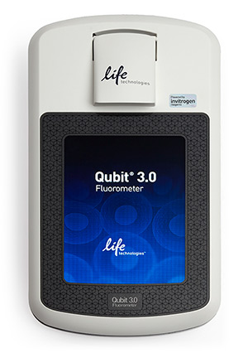
Quantification of DNA/RNA
Use a fluorescent method – Qubit or picoGreen
Dye binds specifically to dsDNA or RNA
In many cases measure both DNA and RNA by Qubit
Nanodrop quantification can be off by an order of magnitude!
Requires ~2uL sample

Slide 9
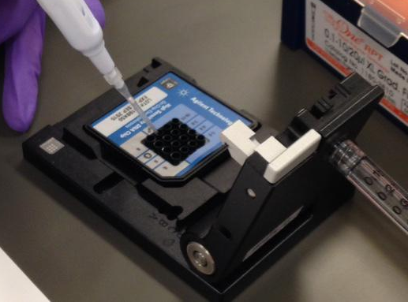
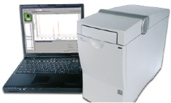
Bioanalyzer – what’s the deal?
Agarose gel meets microfluidics - Measures fluorescence (DNA or RNA) versus time
Great for size estimates at low concentrations
Great for determining quality of total RNA
Not so great for quantification

Slide 10
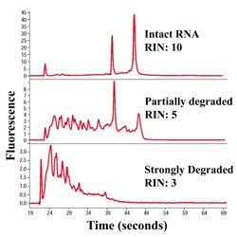
Determination of input RNA quality
RNA Nano (5-500 ng/uL) or RNA Pico (50-5000 pg/uL)
RNA Integrity Number (RIN) indicator of quality
Monitor rRNA depletion

Slide 11
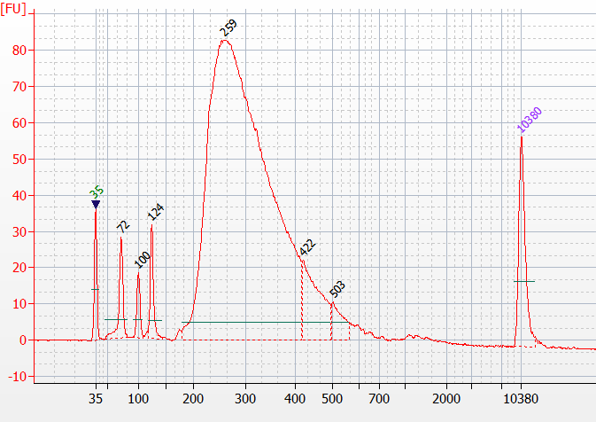
During library construction
High Sensitivity DNA chip (5-500 pg/uL)
Monitor fragmentation (RNA or DNA)
Check for problems:
Over-amplification
adapter-dimer, primer-dimer, excess primers
Determine size range of final library
Adapter-dimer
Excess
primers
Over-amplification

Slide 12
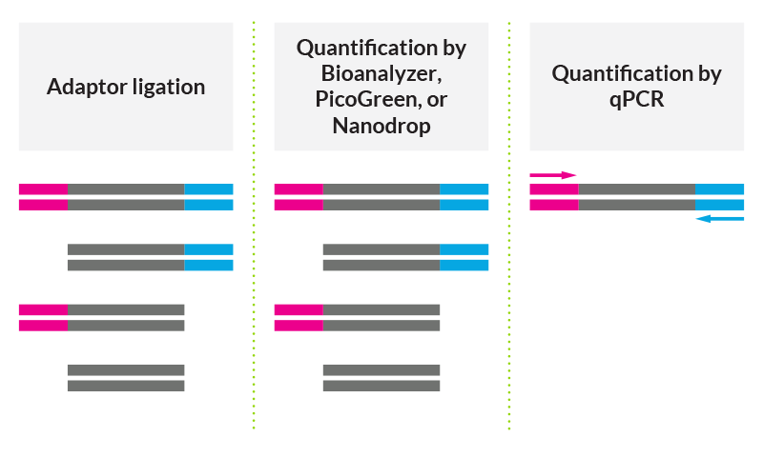
Final QC - qPCR
Primers for P5 and P7 ends of the adapters – only detect molecules with both adapters bound
Requires significant dilution, can lead to large errors
Final concentration calculation depends on the size of your library
Adapter-dimers WILL be amplified (can check on gel after qPCR)

Slide 13
Comparison between methods
Rarely see the same concentration by Qubit, Bioanalyzer and qPCR
Ratios between qPCR:Qubit (molar) typically between 0.8-2.0 for well-performing libraries
Higher ratios may indicate over-amplification or significant adapter-dimer, check the Bioanalyzer
Low ratios may indicate a problem with adapter ligation
It is better to make a new library than to sequence a terrible library!!

Slide 14
QC and sequencing facilities
Every facility has their own proven method – trust the experts and have them do quantification even if you have already done it!
Every instrument is slightly different
Relationship between loading concentration and cluster density is not a simple one!
Everything about your library is important for your sequencing facility to know
Library construction method, quality of input, size distribution, strain/species, potential low sequence complexity, barcoding method, previous performance (if known), etc.

