Slide 1
https://www.youtube.com/watch?v=0eEG5LVXdKo

Slide 2
Short Read Sequencing Analysis Workshop
Day 1
Introduction to the Workshop

Slide 3
Schedule for Week 1
Day 1: Introduction
Workshop syllabus and schedule
Basic considerations for sequencing – depth, read length, format, etc.
Test Logins
Day 2: Introduction to Unix/Vim
Understand how to use local machine to connect to a server/compute cluster
Basic Linux commands, how to set up a command line
VIM text editor
Day 3: Intro to servers & downloading public data
Head node vs. child nodes
Job queues, modules
Troubleshooting failed jobs
Transferring/downloading files to the server
Day 4: Quality Control, Mapping & IGV (Genome Browser Visualization
Evaluating quality of sequencing data with FastQC
Trimming reads, why and how
Understand how & why we map reads
SAM/BAM file formats, Samtools
Introduction to IGV for visualization
Day 5: Assessment and Assistance

Slide 4
Schedule for Week 2
Day 6: RNA-seq (Part 1/2)
read counting,
generating an annotation file,
isoform analysis
Day 7: RNA-seq (Part 2/2) & Nascent Sequencing
wrap up and loose ends on RNA-seq analysis
analyzing Nascent sequencing analysis (primarily GRO/PRO-seq).
Day 8: Variant Calling, DNase-seq, & Single-Cell Sequenc- ing
Variant calling using GATK
single-cell sequencing analysis. 10x genomics
Day 9: ChIP-seq & ATAC-seq
peak calling
motif displacement.
Day 10: Downstream Analysis/ miscellaneous
BEDTools, coordinate math
Basics of data visualization (graphing)
gene ontology (GO/GSEA).

Slide 5
Reverse Classroom
Before class:
Watch Videos http://bficores.colorado.edu/biofrontiers-core-facility-workshops/workshops-in-the-series/
During class (9-12 am)
Examples with example files (fastq, sam, bam, bed)
After class:
Homework
Get help in E1B11 1-3pm

Slide 6
Short read sequencing

Slide 7
Unix/Linux
https://www.youtube.com/watch?v=gAc2oSgCZZI

Slide 8
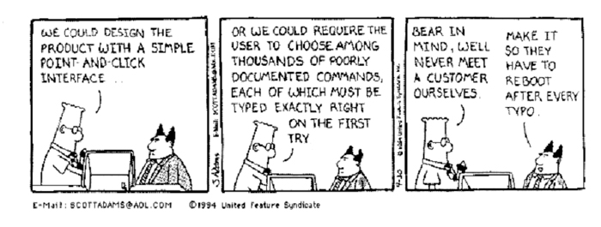
You will be learning “command line”
This is not a GUI
Spelling and Capitalization matter!
Google can help you learn “command line unix”
The names for commands are not always intuitive (you will learn many this week)

Slide 9
Programs we will be using
Text editor – VIM
Sequencing quality – FastQC
Read filtering/trimming – Trimmomatic
Read Mapping – Bowtie2
Visualization – IGV
Variant Calling – GATK toolkit, PicardTools
Peak Calling (ChIP-Seq) – MACS
Motif calling – MEME Suite, TomTom
RNA-Seq mapping (splice-aware) – Tophat2
Differential Expression – HTseq, DESeq, Cufflinks
Other programs: Samtools, BEDTools

Slide 10
What this workshop won’t cover
De novo assembly (genome or transcriptome)
16s metagenomics
Shotgun metagenomics
Long-read data analysis
Specialized analysis beyond the basics
Coding
Biostatistics
How to analyze YOUR data

Slide 11
Login
Mac
open a terminal
ssh <username>@server
PC
open MobaXTerm or Linux Bash Shell or Windows Subsystem for Linux

Slide 12
Logout
type exit or logout

Slide 13
If you have a problem on the cloud
Check for typos.
Check your input directories and output directories.
Did you load the necessary modules?
Check for typos again.

Slide 14
If you have a compute problem
Please be courteous. BIT graciously gives their time for this workshop, we couldn’t do it without them
All helpers and teachers are volunteers
Having trouble?
Email bit-help@colorado.edu to submit a ticket
Put “SR2018” in the subject line
Include your github username somewhere in the email
Be as specific as possible description of the problem
Include the exit and error files or the path to the e and o files.

Slide 15
Bioinformatics is not “free”
Compute Resources ($1500)
Storage (and Backup)
Analysis time
Expertise
Extracting meaningful information requires more than basic bioinformatics
And we haven’t even discussed biostatistics...
http://massgenomics.org/2015/10/ngs-analysis-not-free.html

Slide 16
There is no One Right Answer
Every algorithm/pipeline is different
Different assumptions
Different order of processing can have significant effect
Different options can have a significant effect
Most projects will require some customization or further processing to get useful data
Zhang ZH, et al. (2014) PLoS ONE 9(8)

Slide 17
Important Considerations for Bioinformatics
Keep a digital notebook:
What programs and version are being used
What options or variables are being used
What order programs are being called in the pipeline
What compute environment
If you don’t know these answers and report them in publication, your work will not be repeatable!

Slide 18
When to think about your analysis
Don’t wait until you have the data to think about bioinformatics
Important experimental considerations
Controls, replicates, sequencing depth, library prep, etc. all effect what type of analysis and how powerful it is to tell you something
But if you did...
All is not necessarily lost
Many bad data sets have useful information, can be harder to find and may limit what you can find

Slide 19
vimtutor
open a terminal
type vimtutor
follow instructions
to close vim---
:q

Slide 20
Acknowledgements
Next Generation Seq Core
Funding: BioFrontiers Institute and Colorado Office of Economic Development and International Trade
Compute Resources: BioFrontiers IT Staff
Additional Acknowledgments
DnA Lab (Dowell and Allen)
Volunteers
©2017

